Slide 1

General Meeting 30.03.2023

Slide 2
Agenda
Show some preliminary results
Need code for assigning GGM to the traces

Slide 3
Encoder
Inspired by Feature Pyramids; More like Feature tents

Slide 4
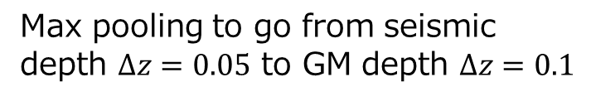
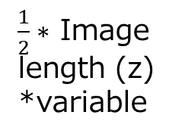
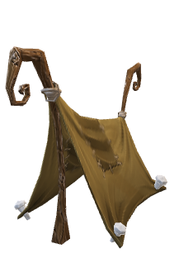
_________________________________________________________________
Layer (type) Output Shape Param #
=================================================================
gaussian_noise (GaussianNoise) (None, 11, None, 1) 0
random_flip (RandomFlip) (None, 11, None, 1) 0
zero_padding2d (ZeroPadding2D) (None, 11, None, 1) 0
conv2d (Conv2D) (None, 9, None, 16) 160
zero_padding2d_1 (ZeroPadding2D) (None, 9, None, 16) 0
conv2d_1 (Conv2D) (None, 7, None, 32) 4640
max_pooling2d (MaxPooling2D) (None, 7, None, 32) 0
dropout (Dropout) (None, 7, None, 32) 0
zero_padding2d_2 (ZeroPadding2D) (None, 7, None, 32) 0
conv2d_2 (Conv2D) (None, 5, None, 64) 18496
dropout_1 (Dropout) (None, 5, None, 64) 0
zero_padding2d_3 (ZeroPadding2D) (None, 5, None, 64) 0
conv2d_3 (Conv2D) (None, 3, None, 64) 36928
dropout_2 (Dropout) (None, 3, None, 64) 0
zero_padding2d_4 (ZeroPadding2D) (None, 3, None, 64) 0
conv2d_4 (Conv2D) (None, 1, None, 64) 36928
dropout_3 (Dropout) (None, 1, None, 64) 0
conv2d_5 (Conv2D) (None, 1, None, 16) 1040
reshape (Reshape) (None, None, 16) 0
=================================================================
Total params: 98,192
Trainable params: 98,192
Non-trainable params: 0
_________________________________________________________________
Input shape = (None, 11, None, 1)
Monochrome seismic image
Batch #
Image Width
Image length (z) *variable
Step wise collapse of width dim down to 1
Max pooling to go from seismic depth $Δz=0.05$ to GM depth $Δz=0.1$
Output shape = (None, None, 16)
Latent units
Batch #
$\frac{1}{2}∗$ Image length (z) *variable

Slide 5

Preliminary results

Slide 6
LSTM Decoders
Not going to be used most likely

Slide 7
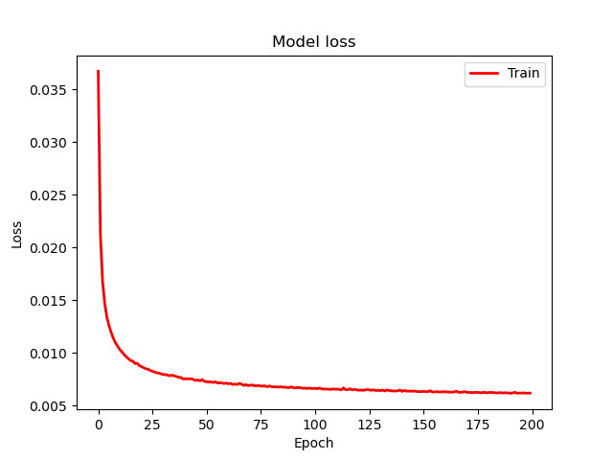

Slide 8
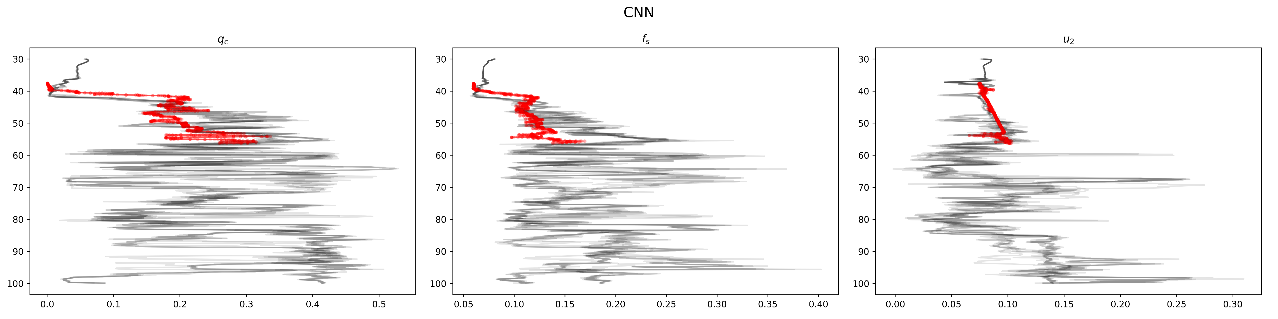
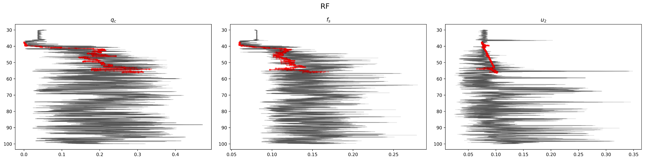
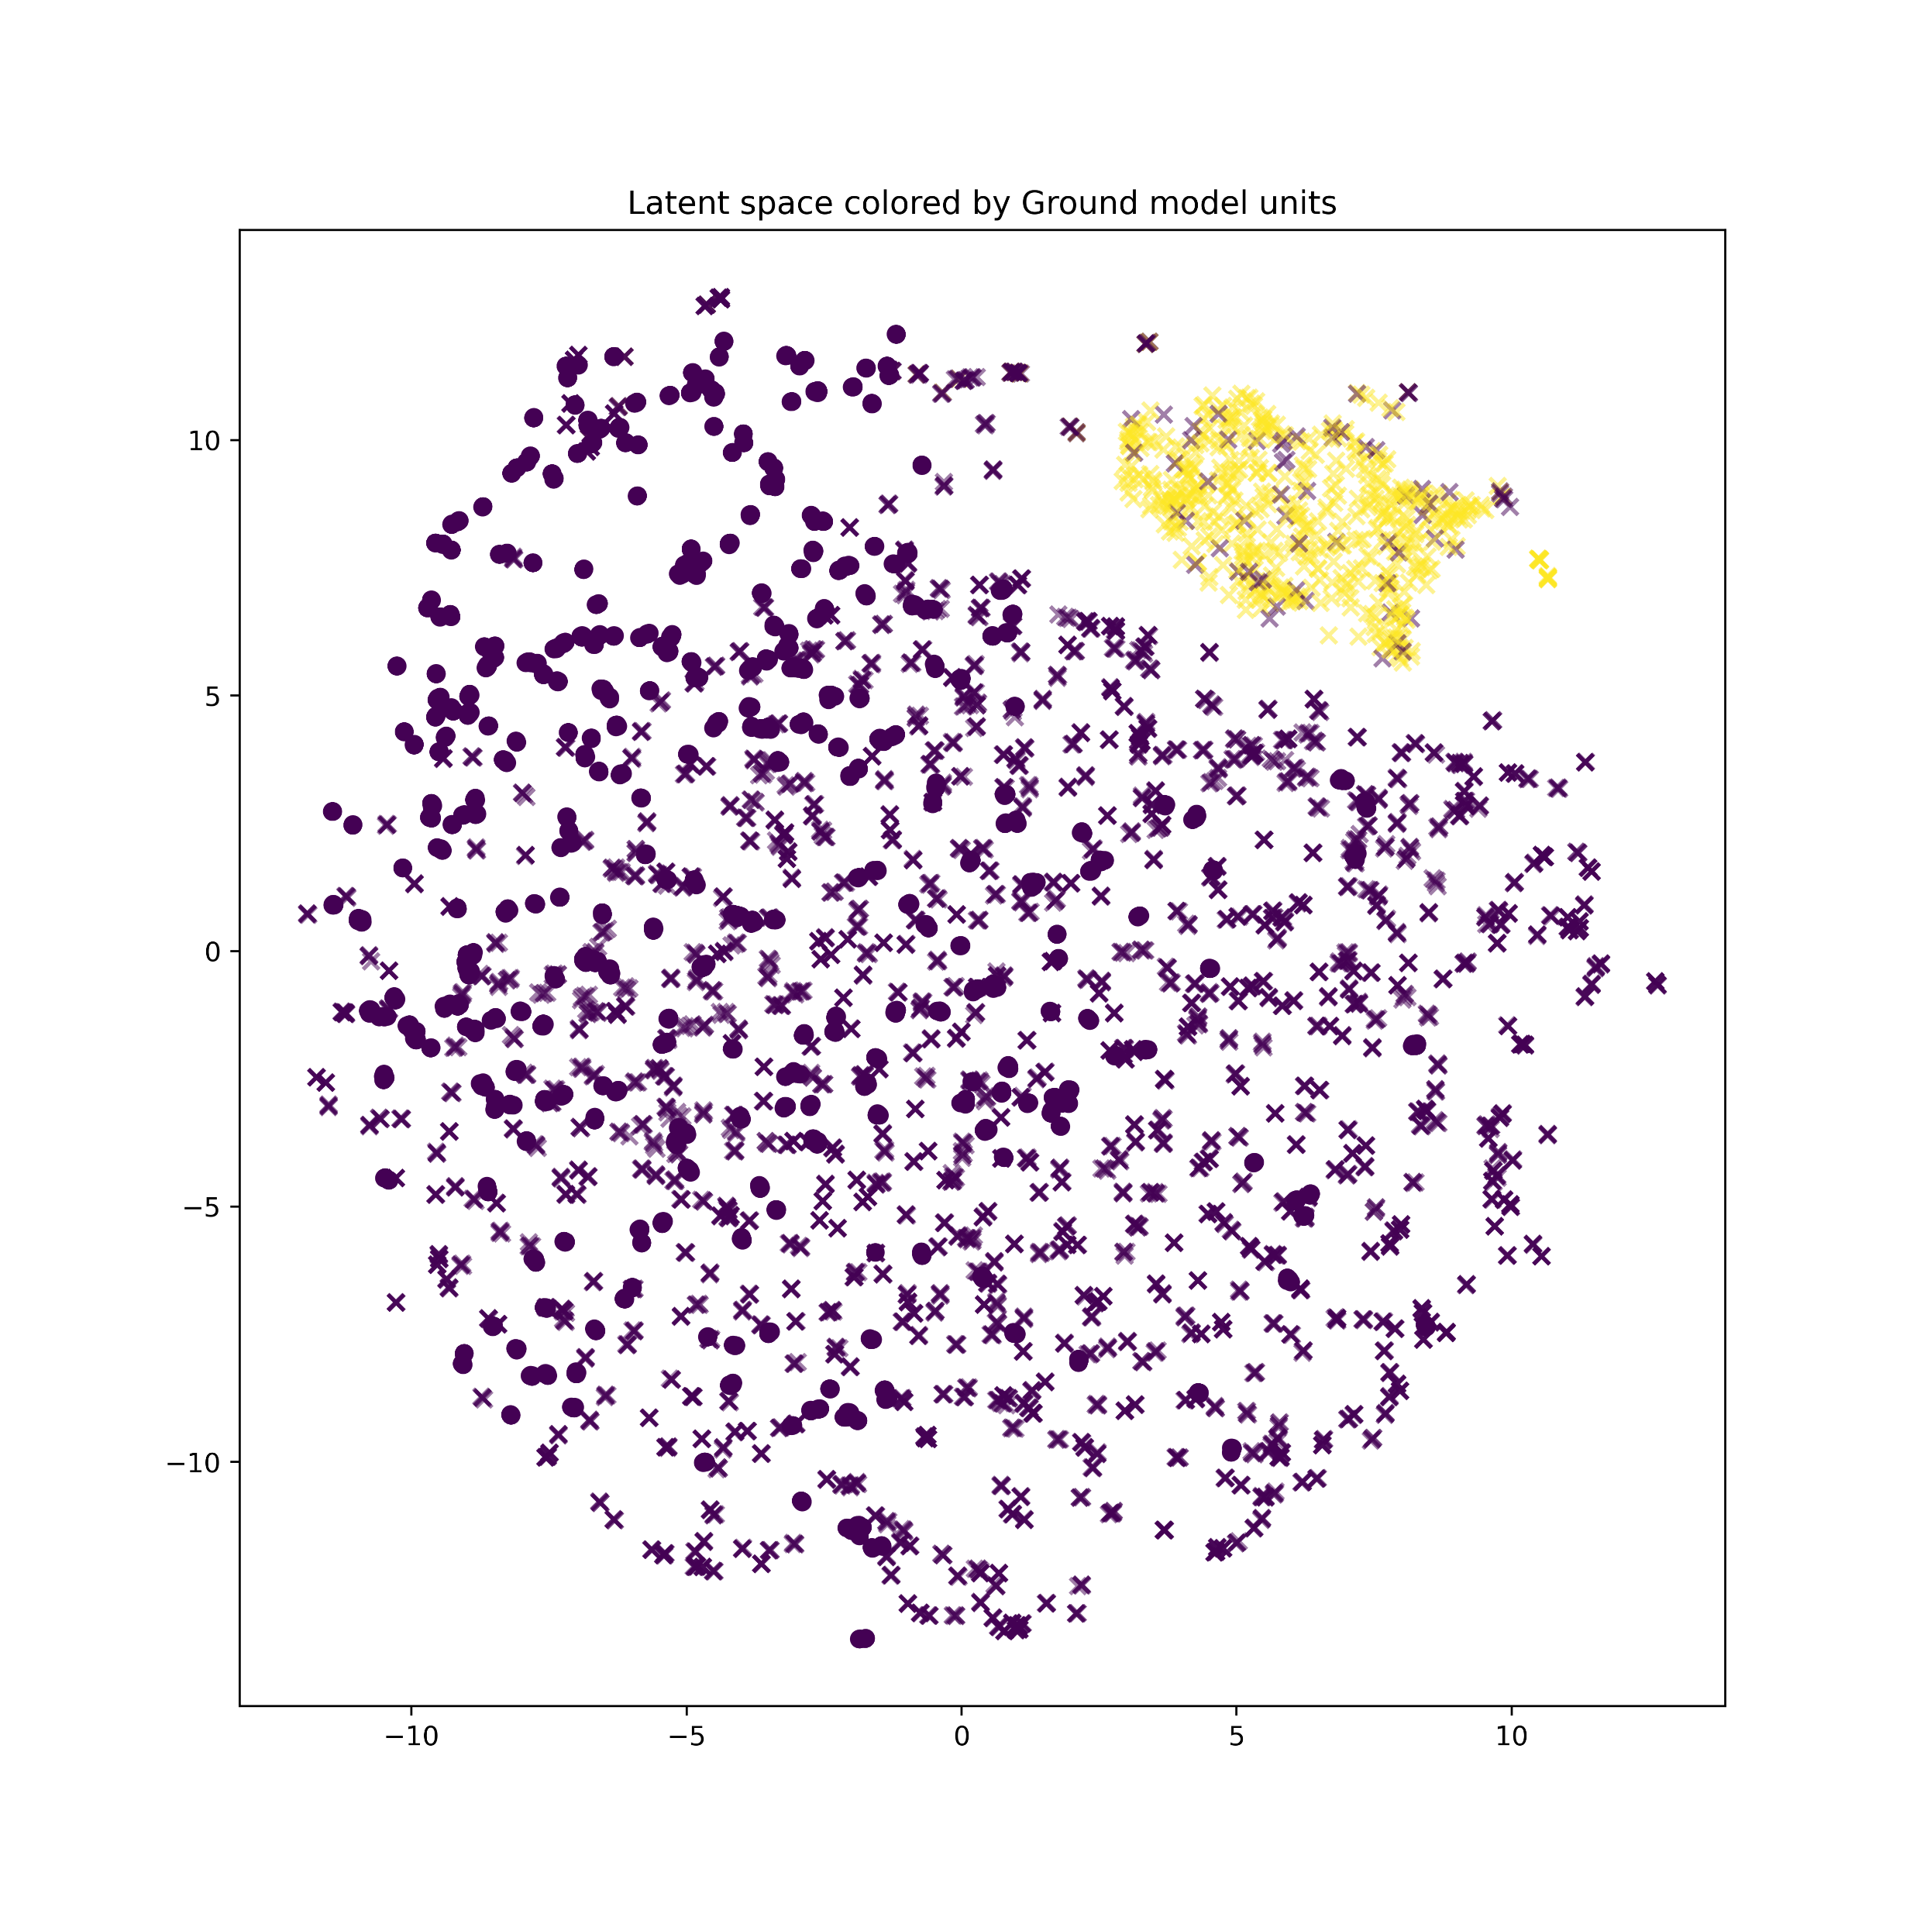
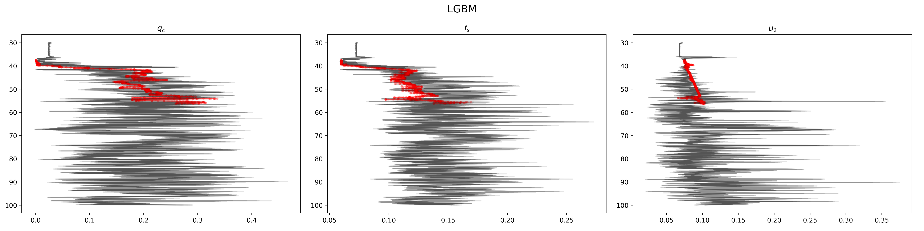
Incorrectly named
Large variability in Tree models; means latent space is not well ordered

Slide 9
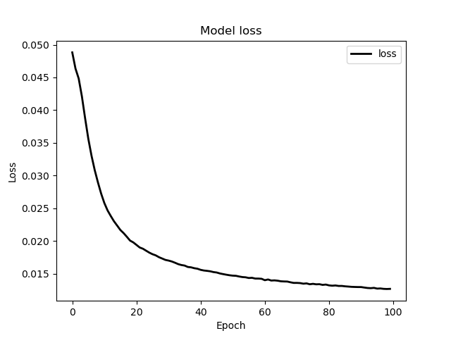
ANY/Fold1

Slide 10
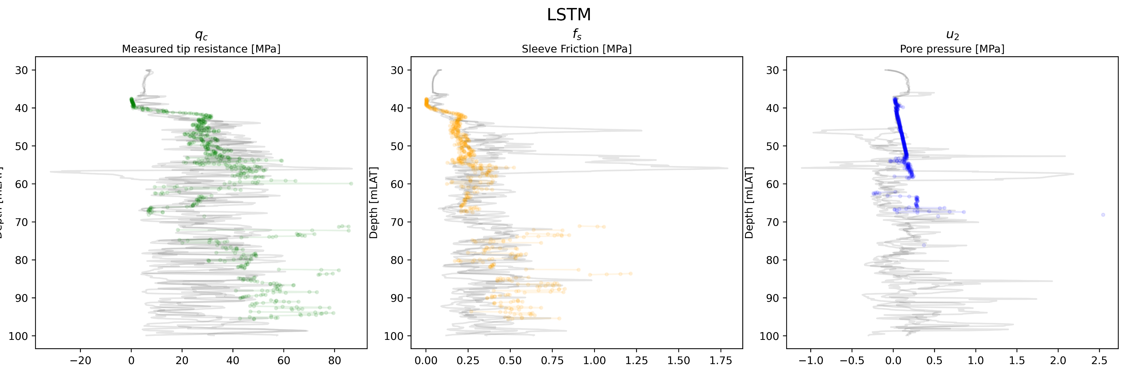
Now scaling back up when comparing
Some anomalous values for the different bootstraps, model is likely sensitive to noise

Slide 11
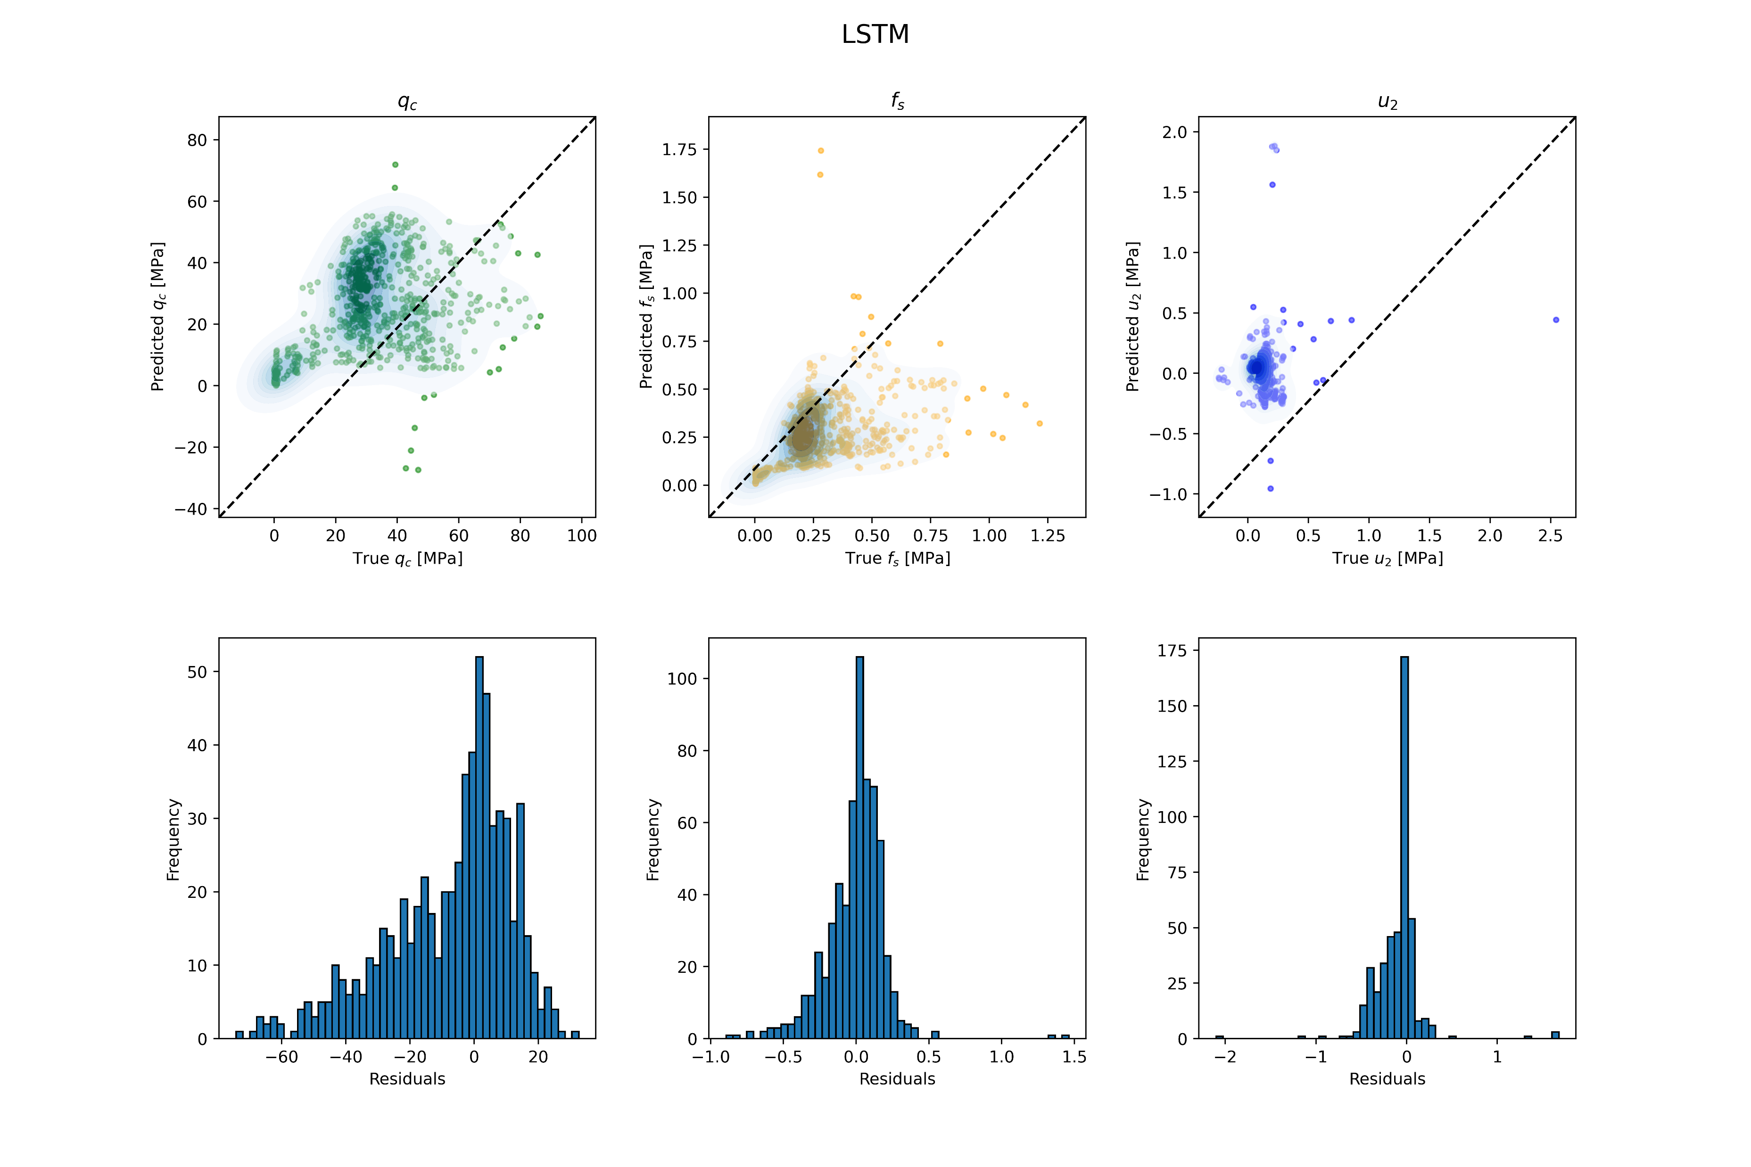

Slide 12
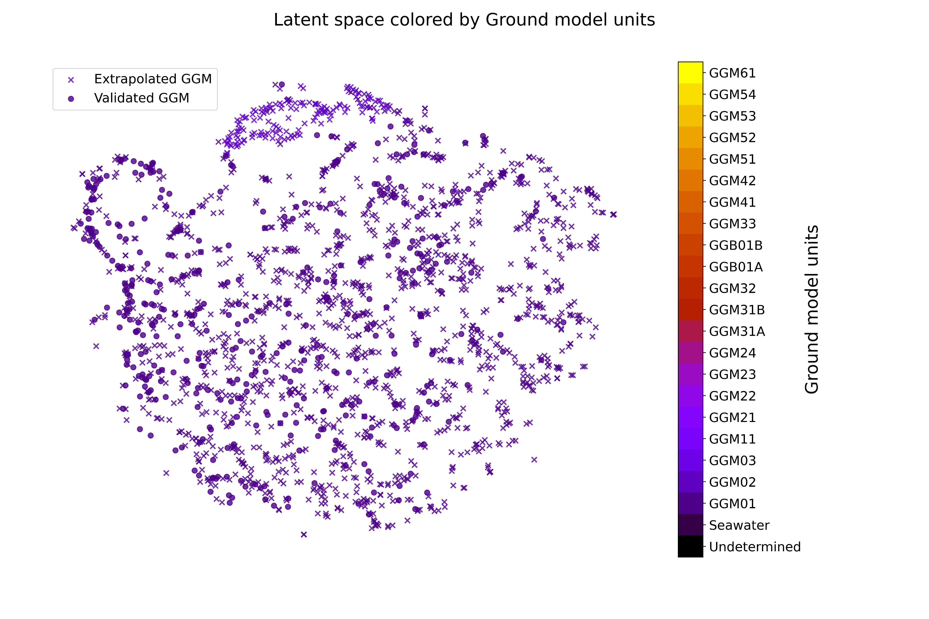

Slide 13
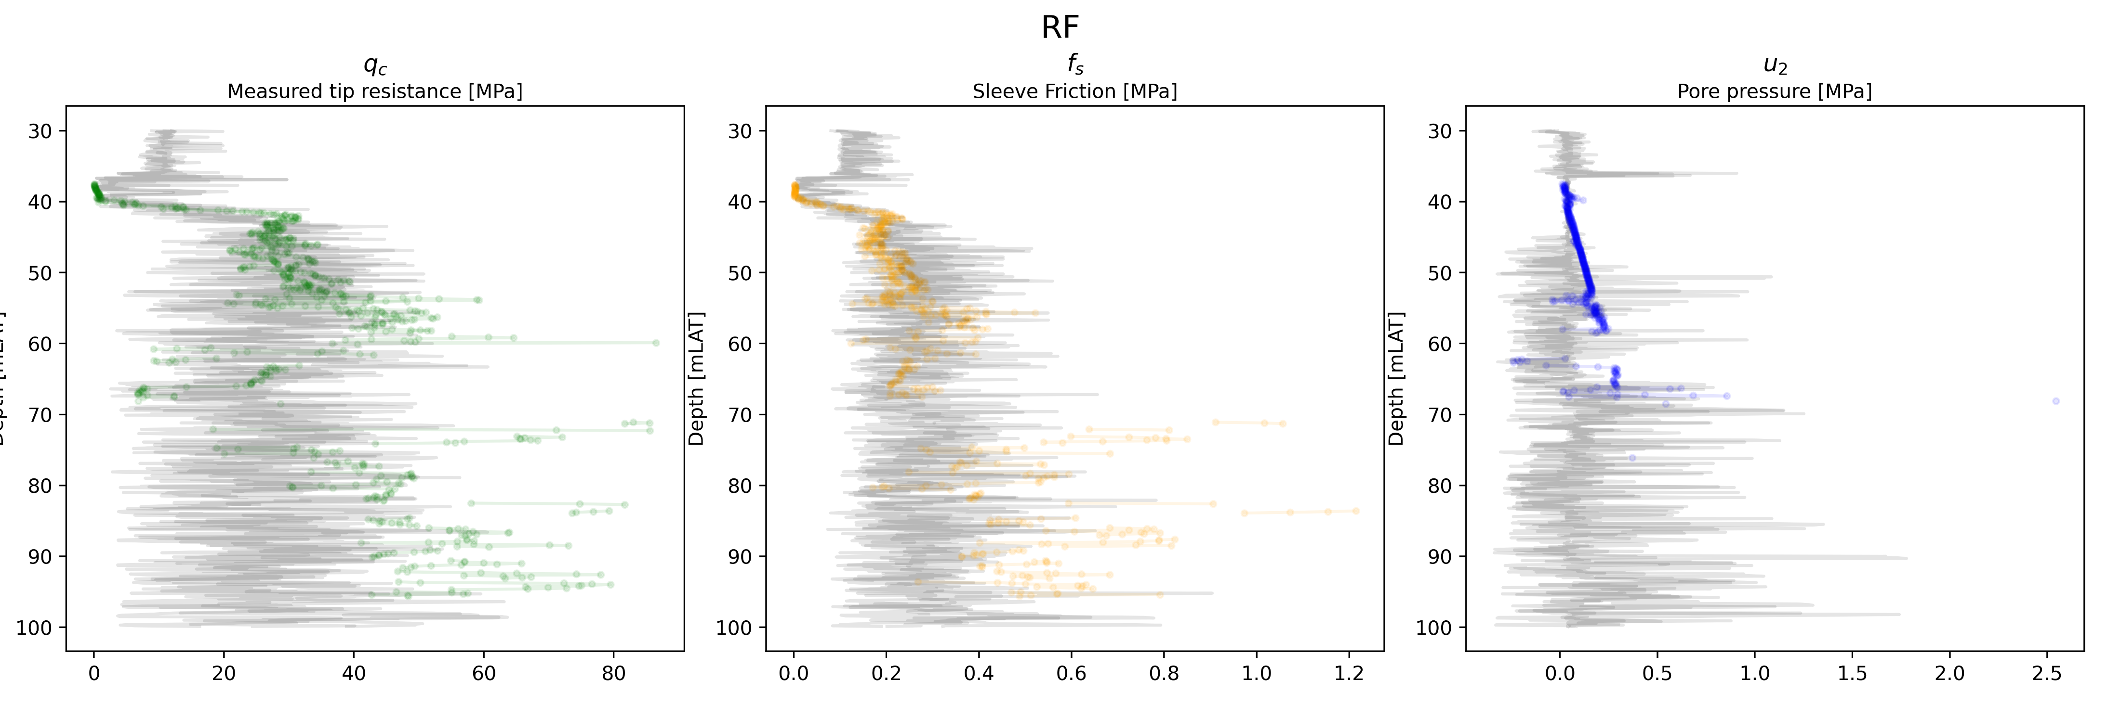
Random forest on latent units

Slide 14
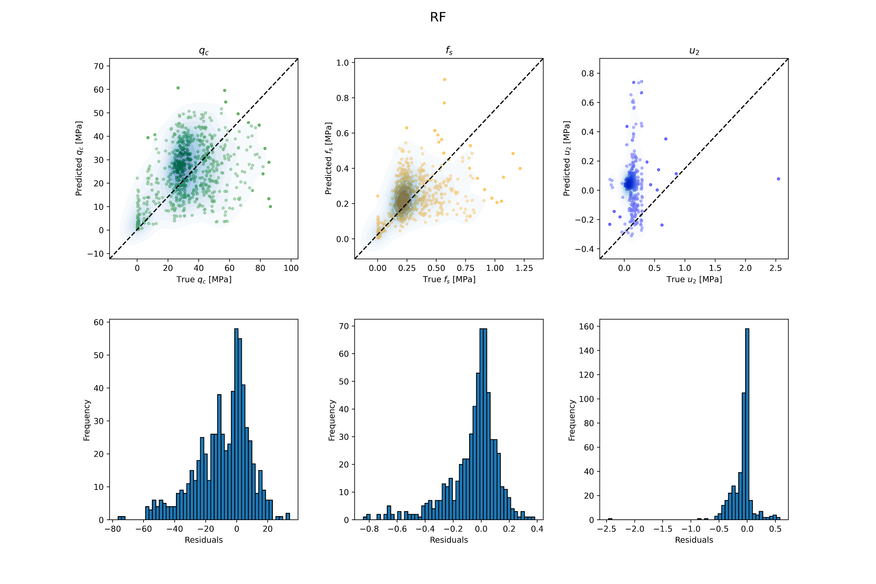

Slide 15
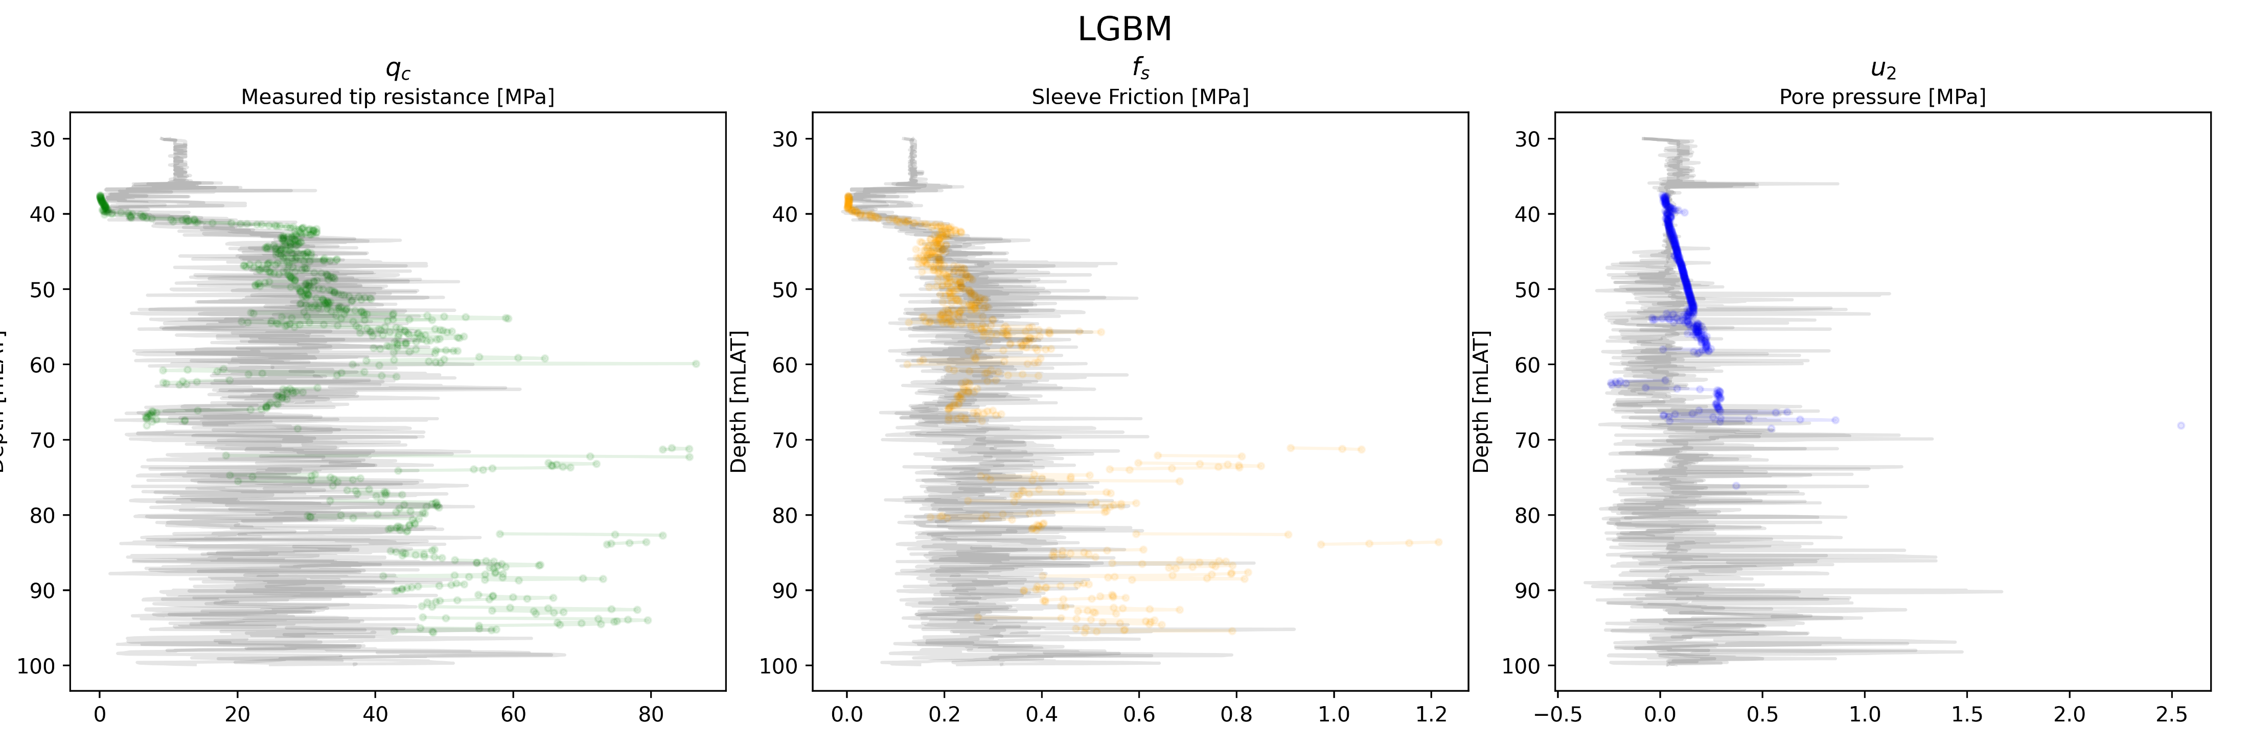
LGBM on latent units

Slide 16


Slide 17
CNN Decoders

Slide 18
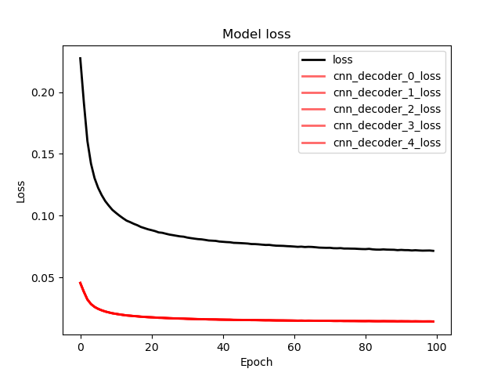

Slide 19
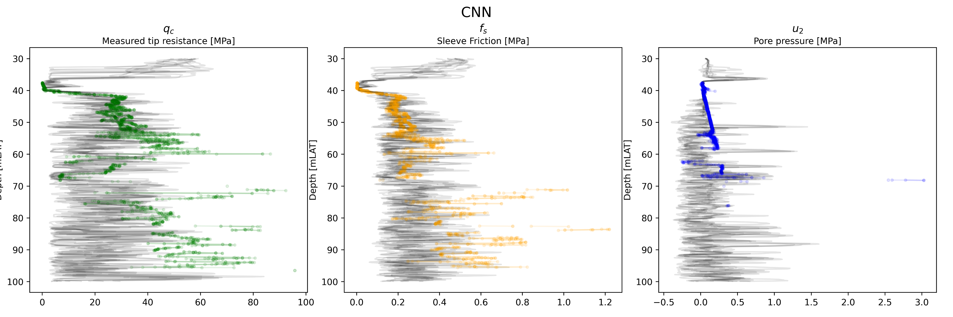

Slide 20
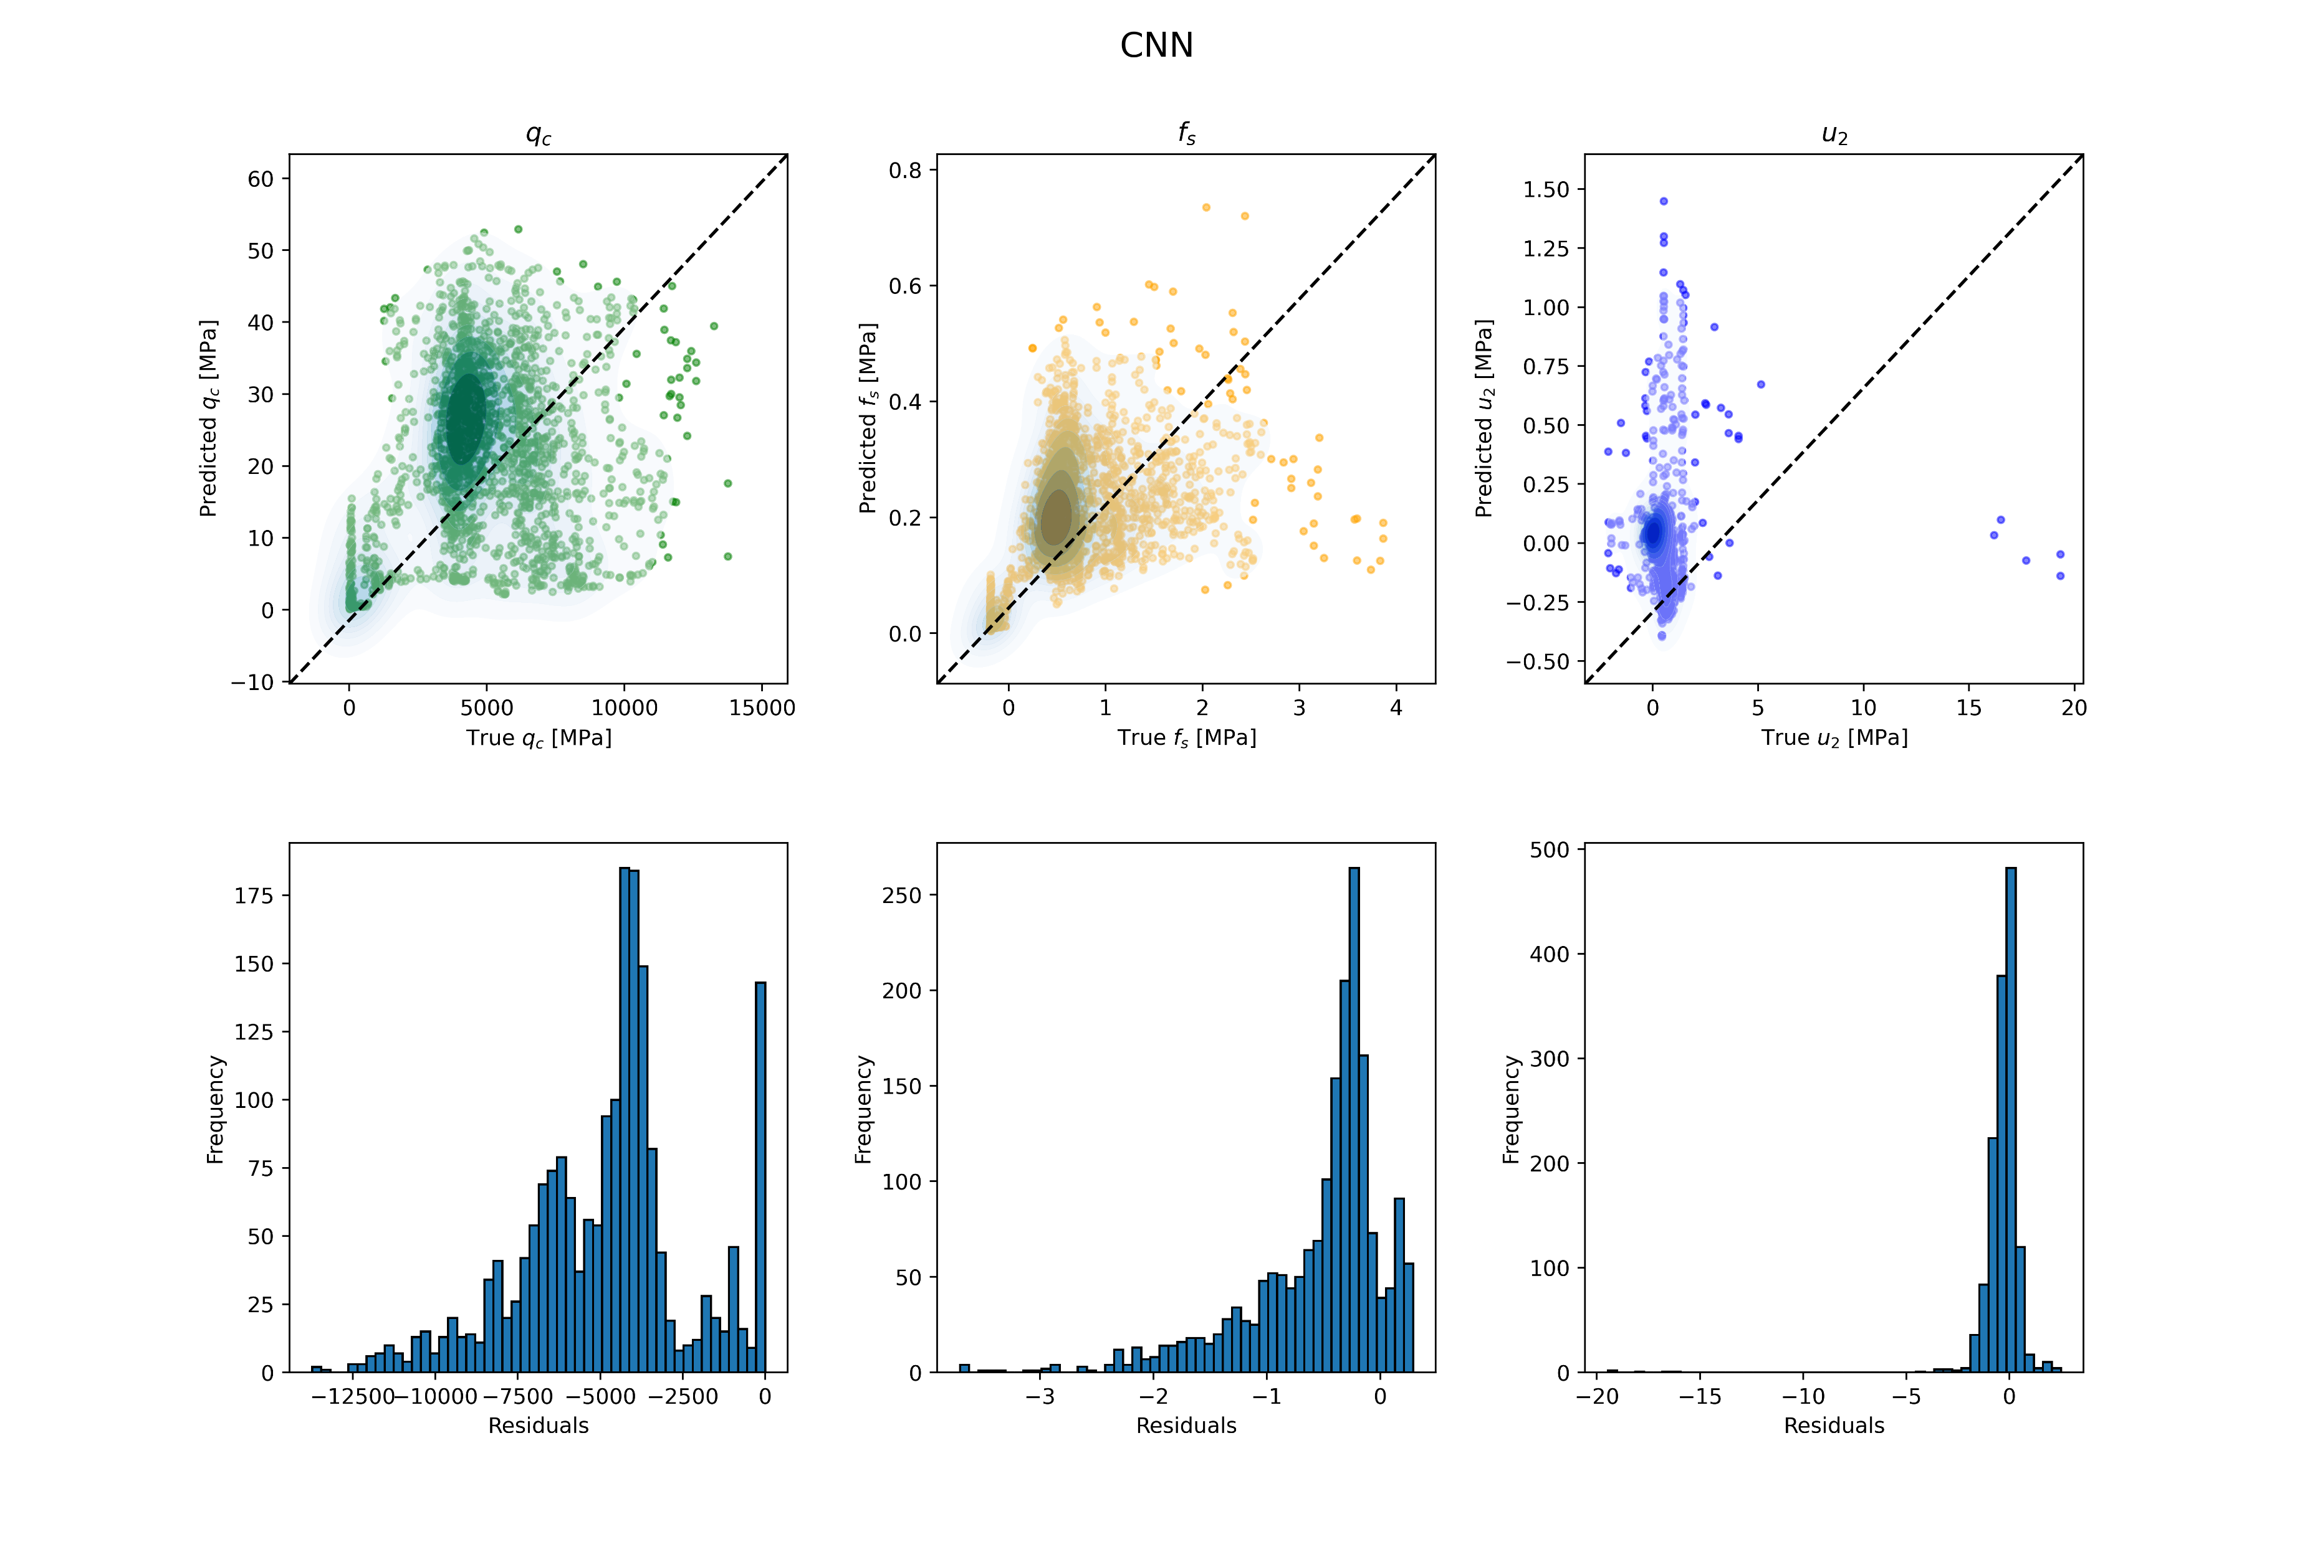

Slide 21
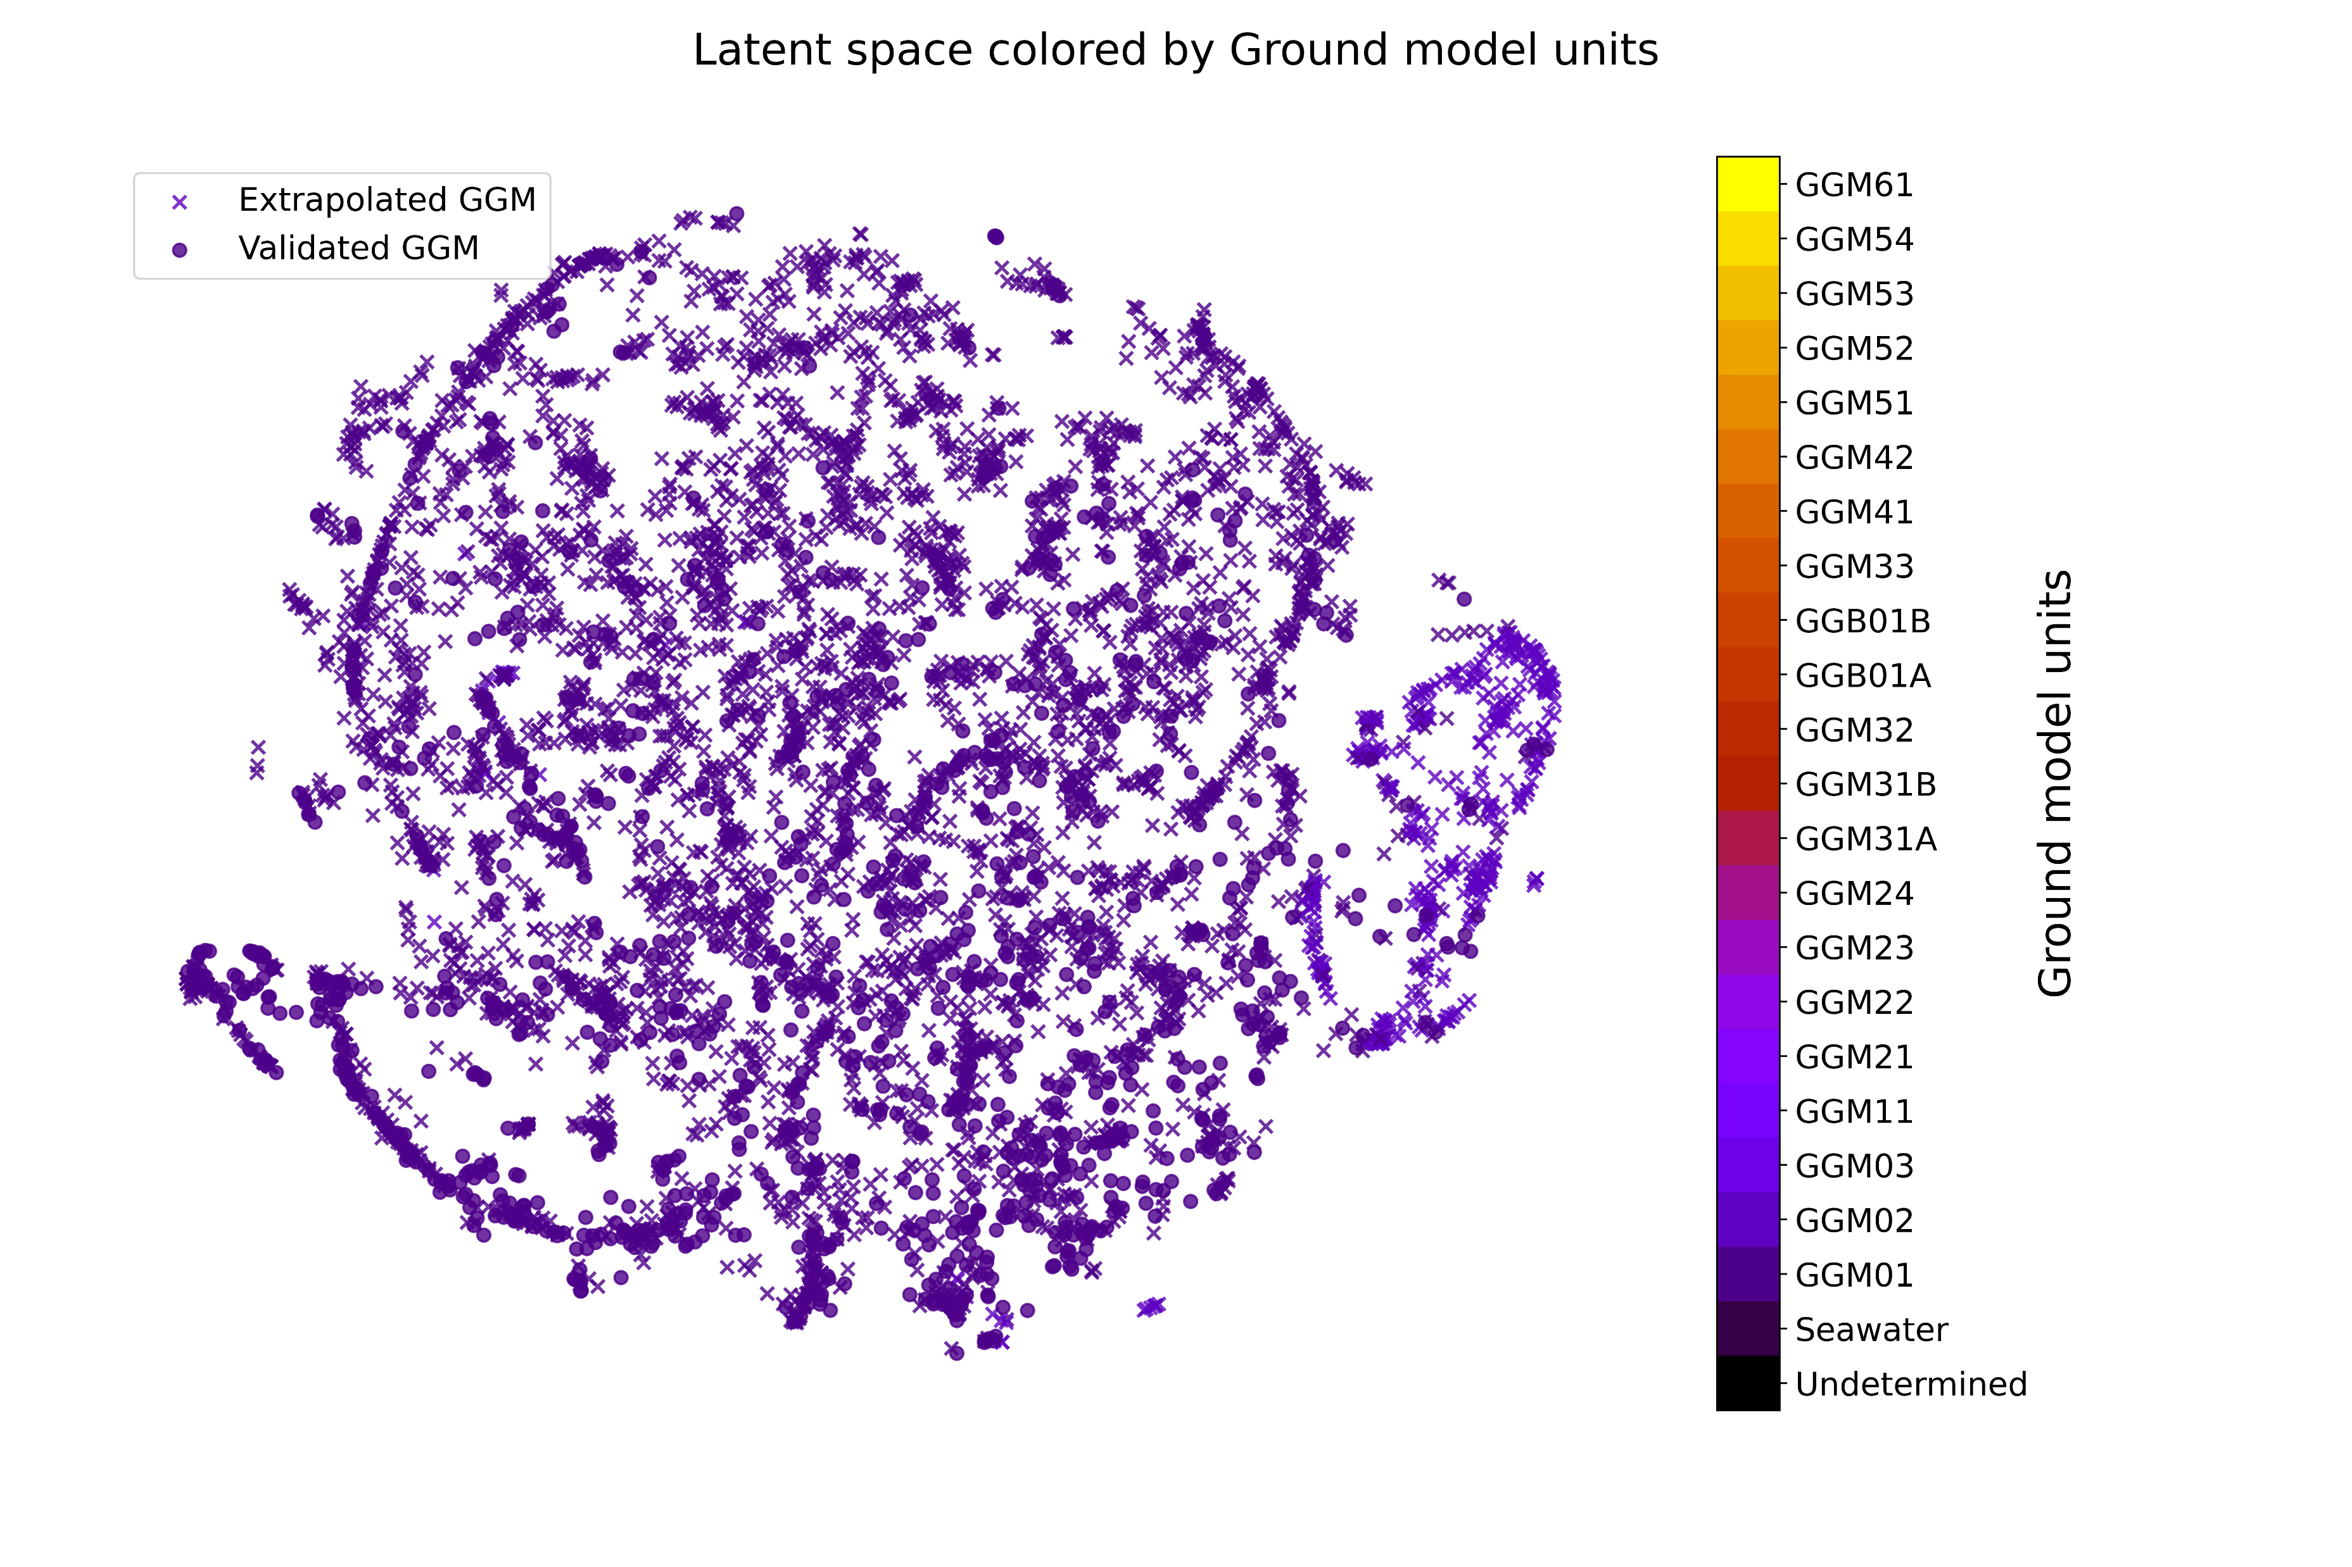

Slide 22
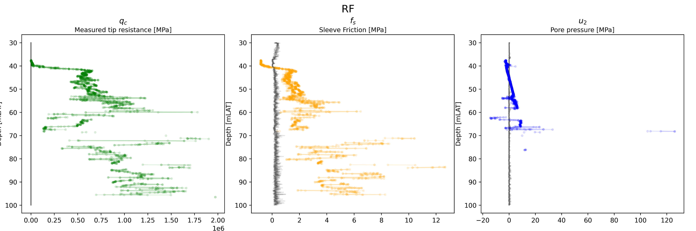
Tree models were not visualized since there was an error in the plotting code

Slide 23
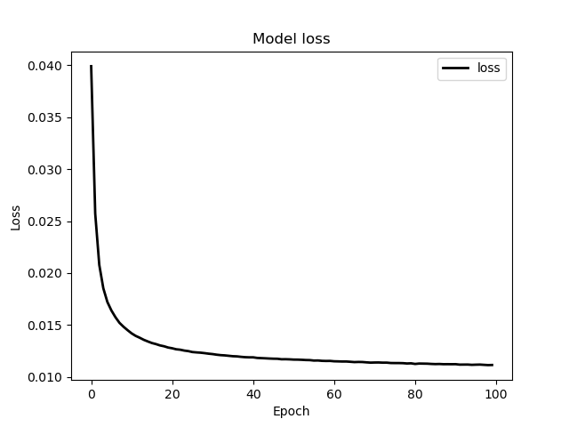

Slide 24
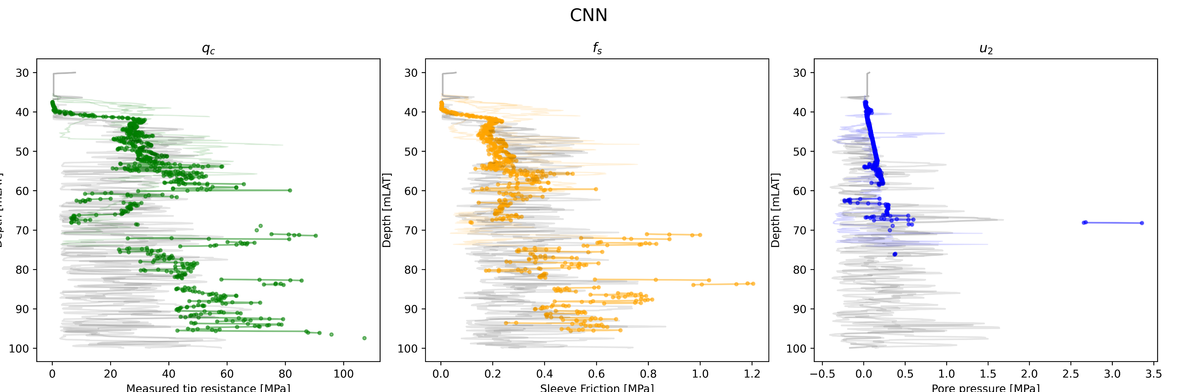

Slide 25
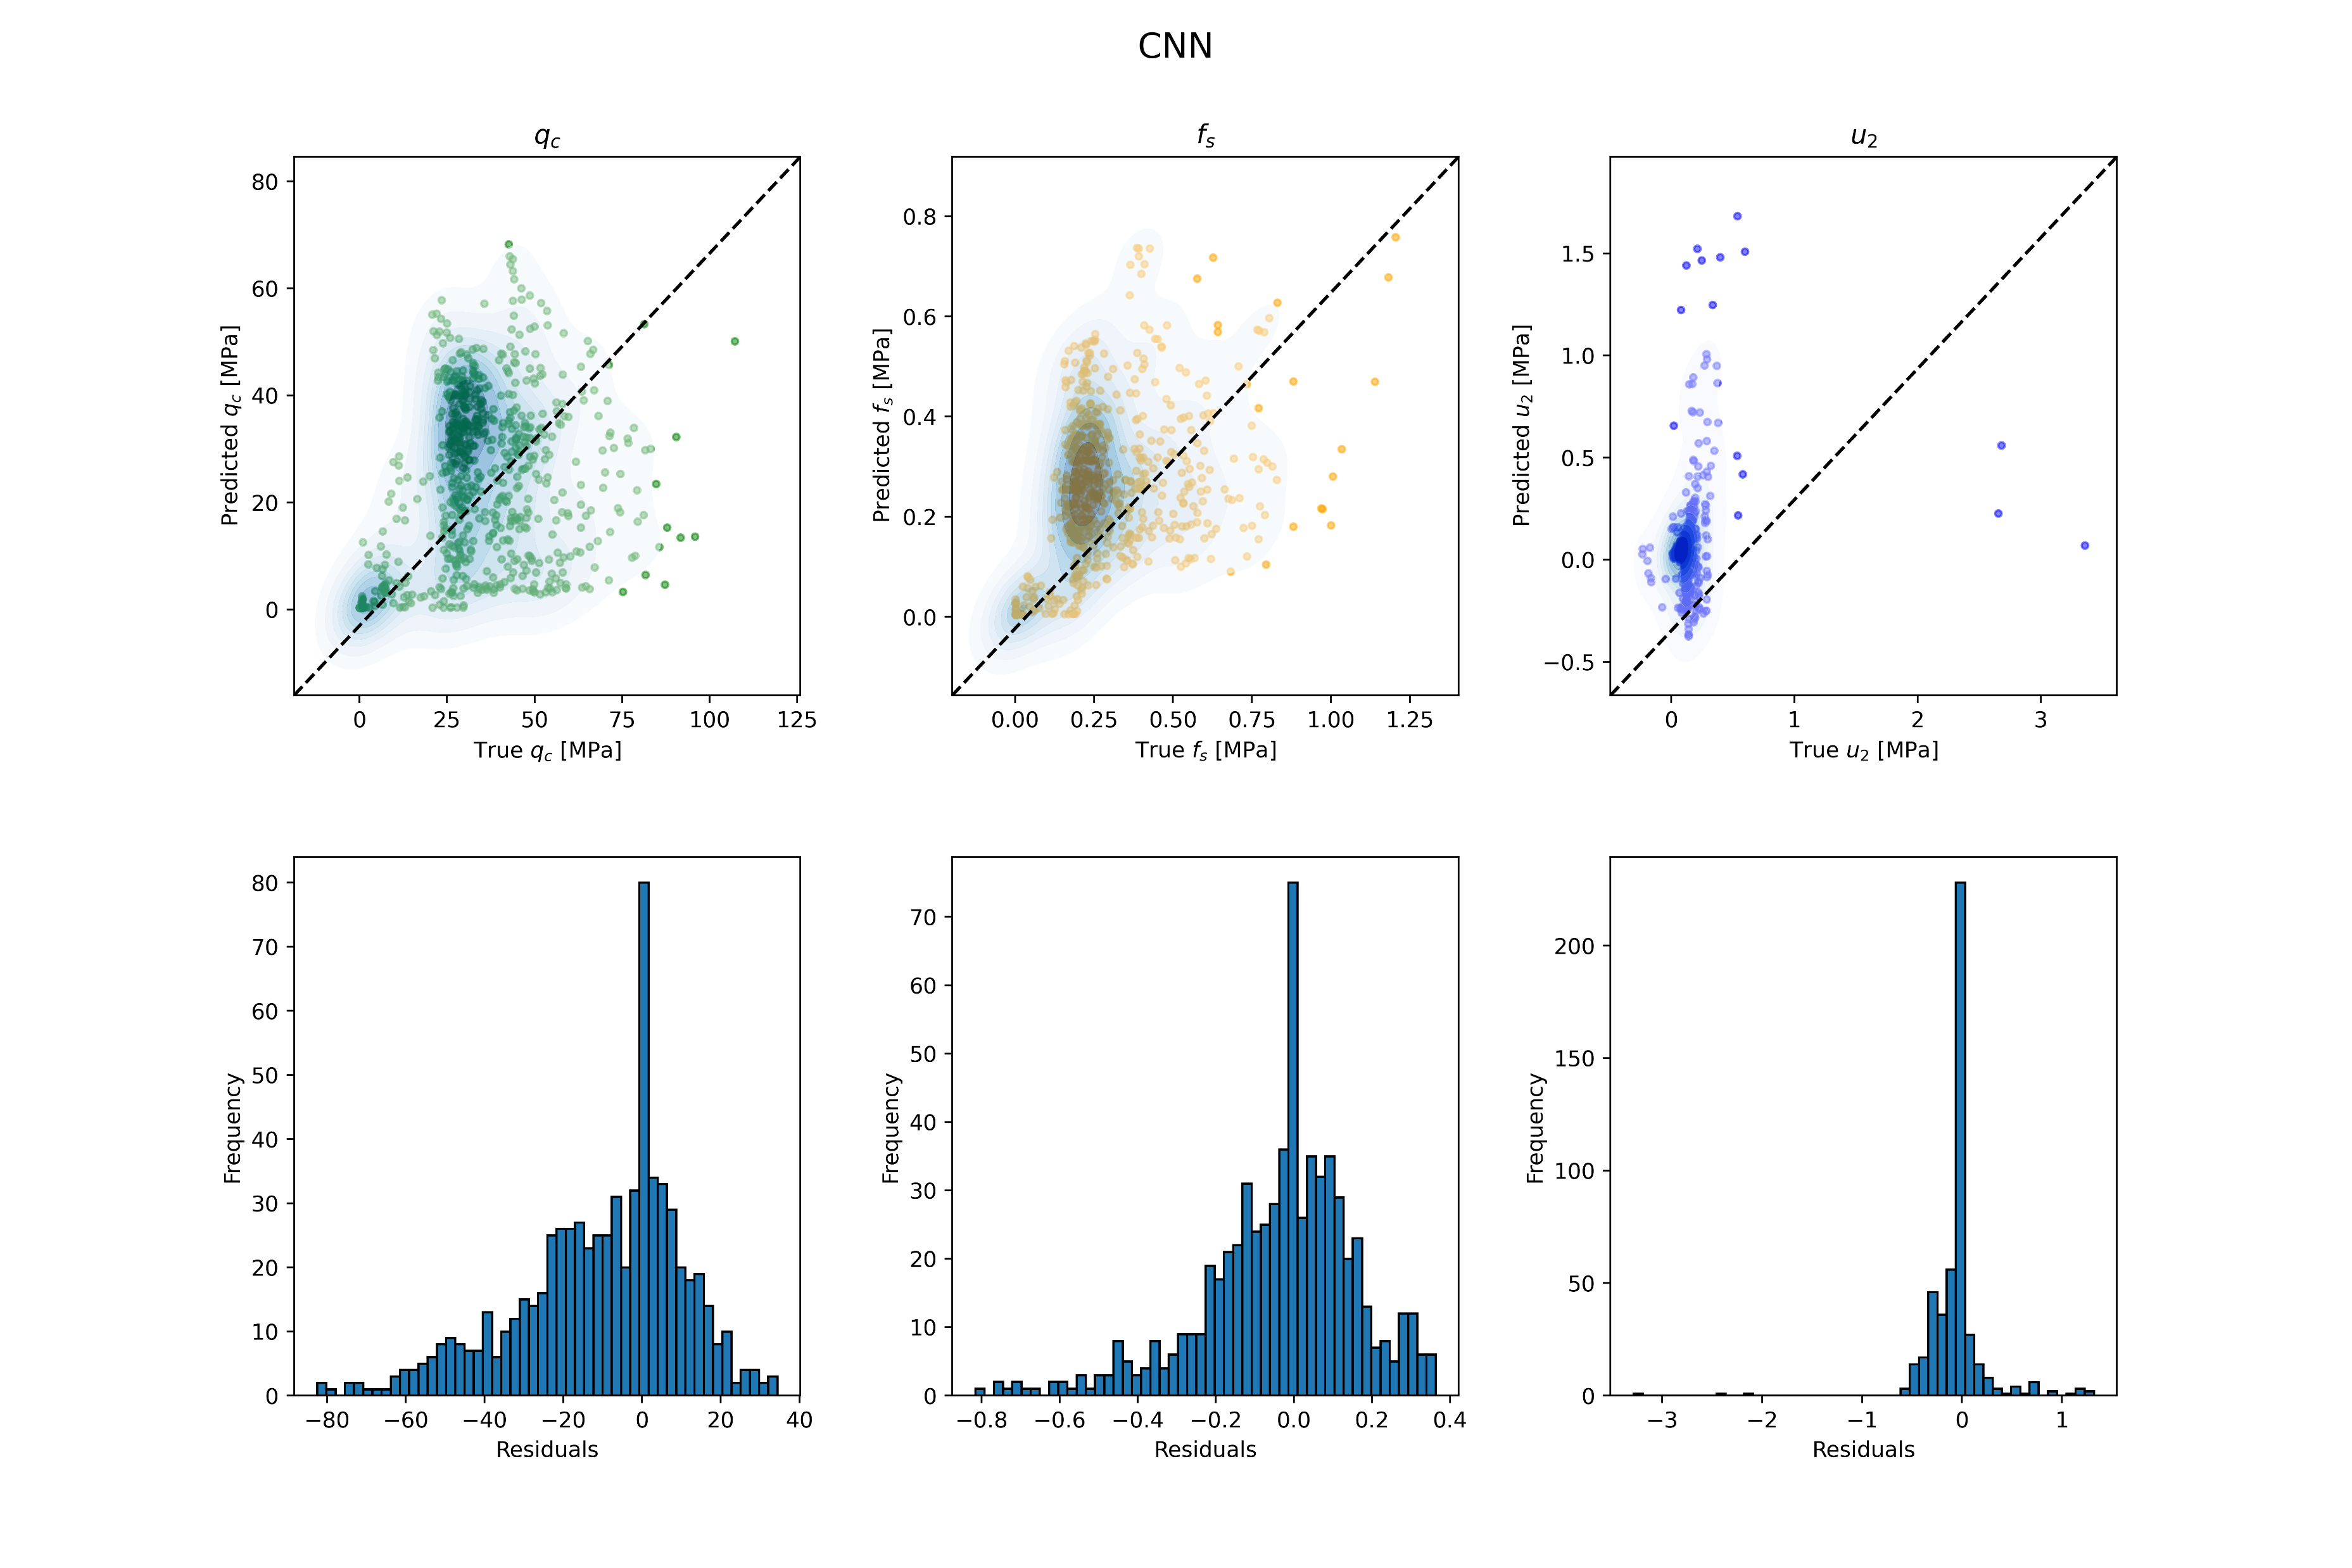

Slide 26
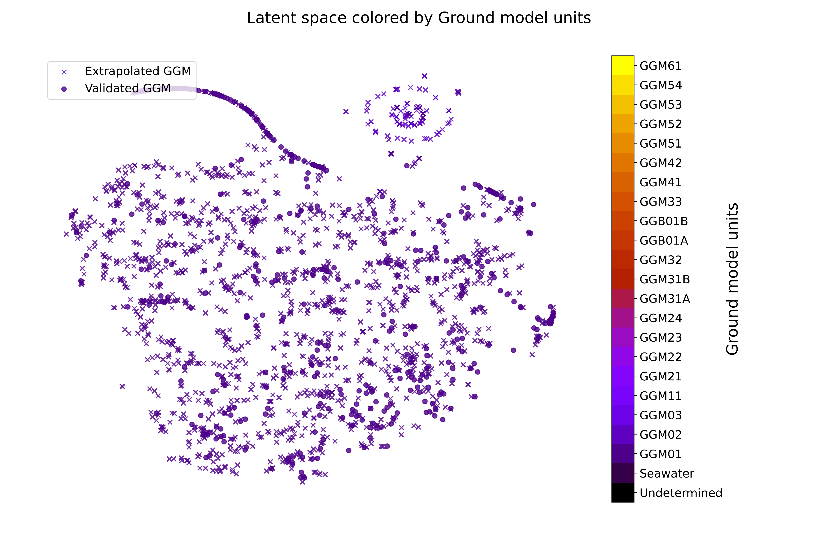

Slide 27
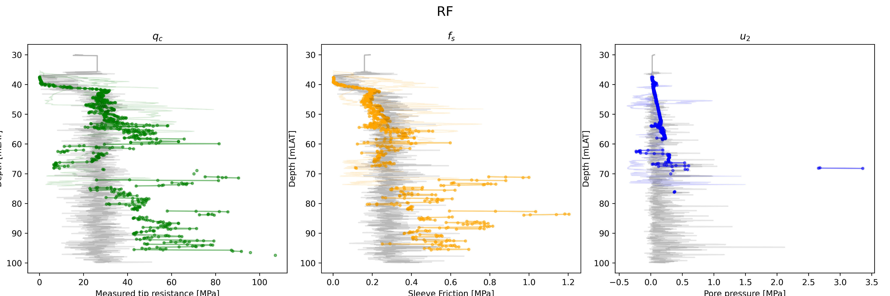

Slide 28
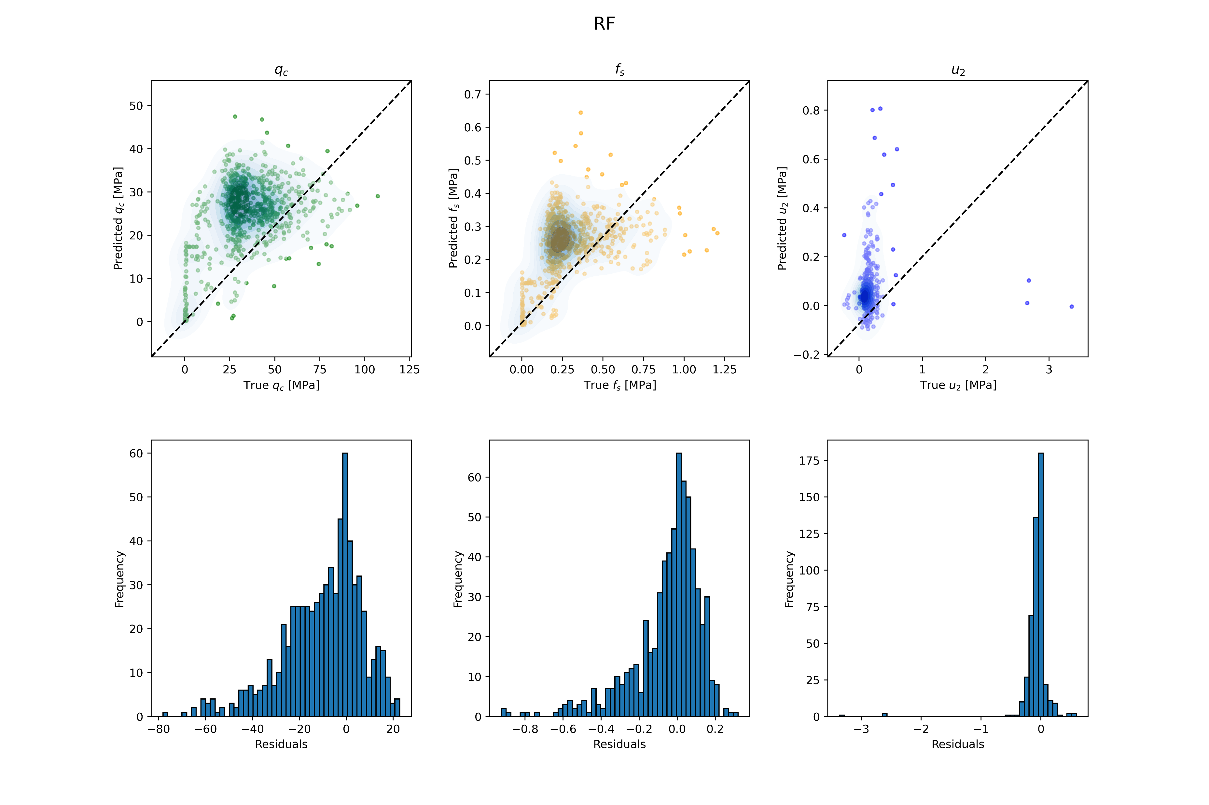

Slide 29
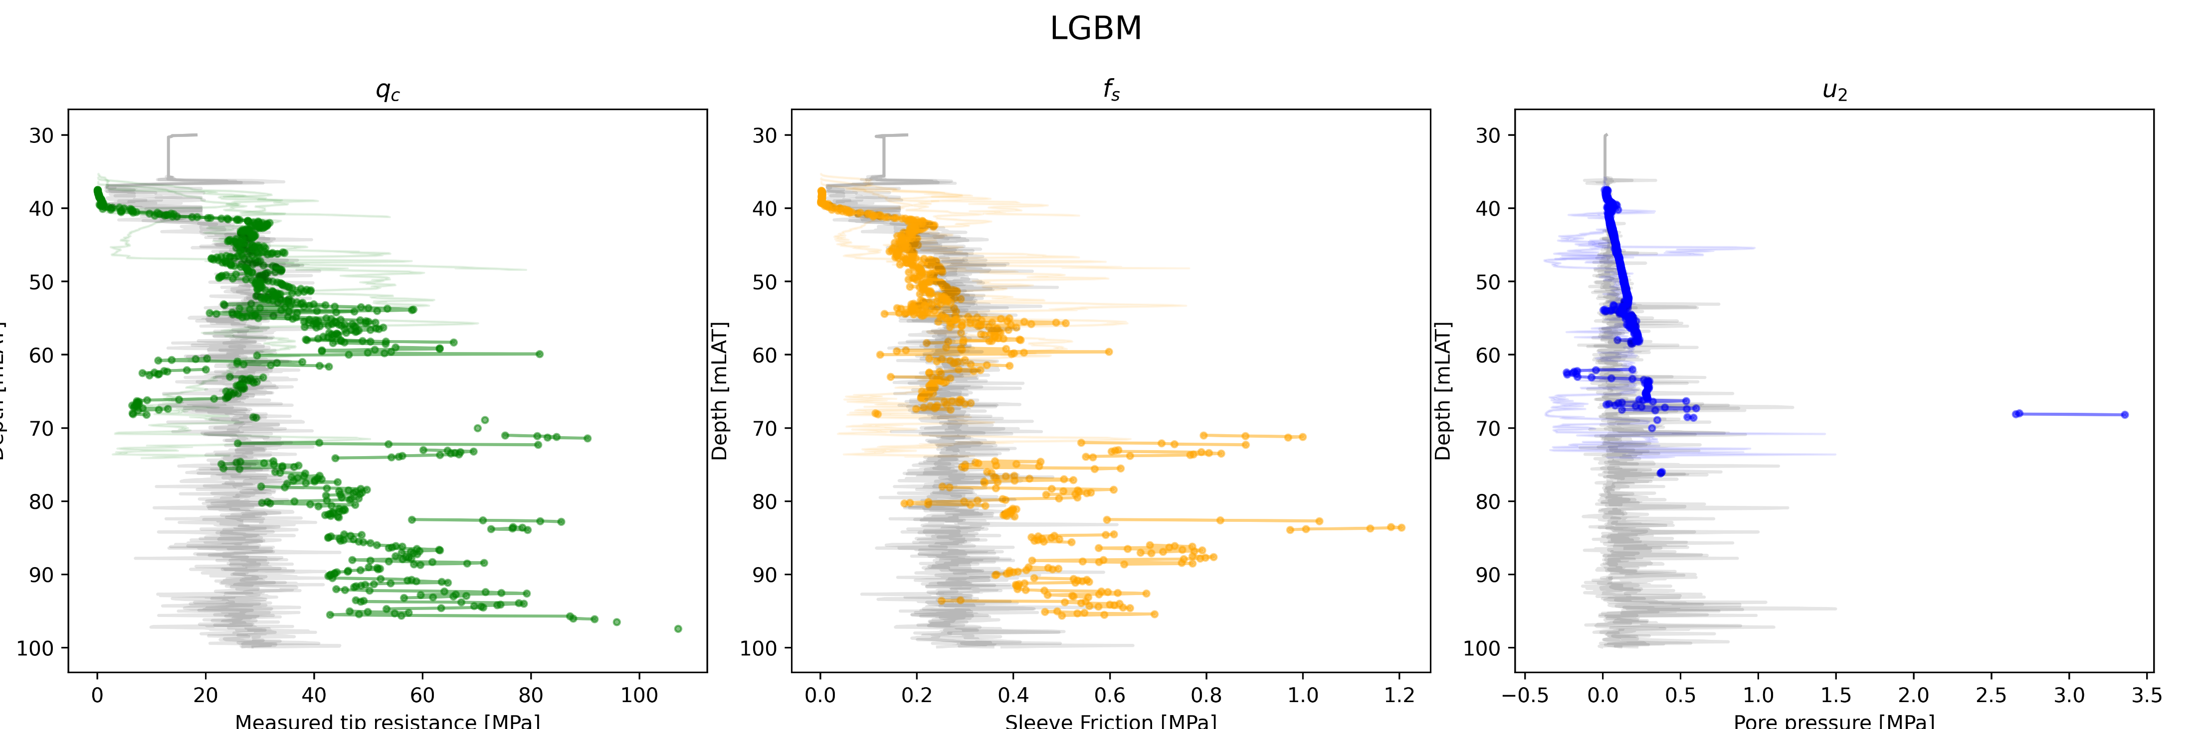

Slide 30
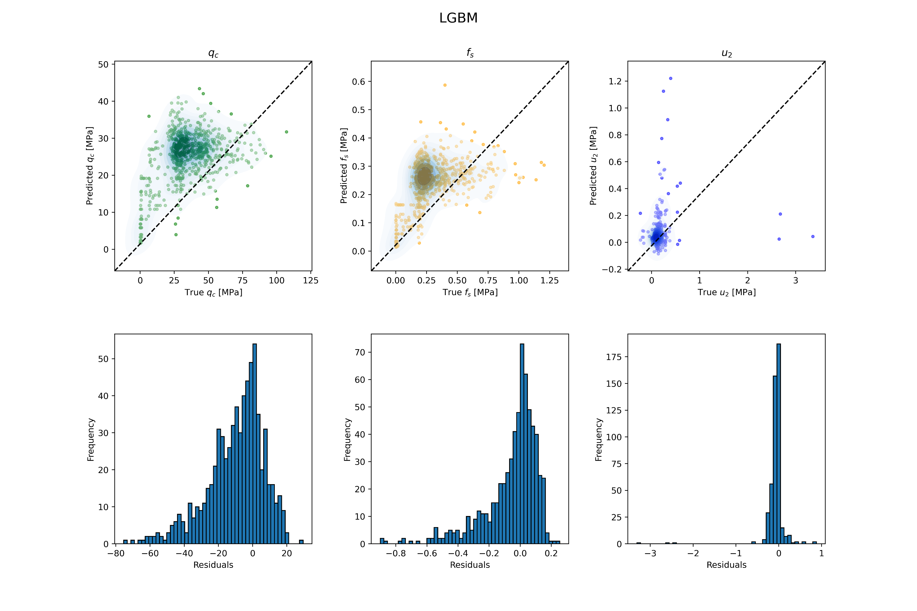

Slide 31
Ensemble ANN decoders

Slide 32
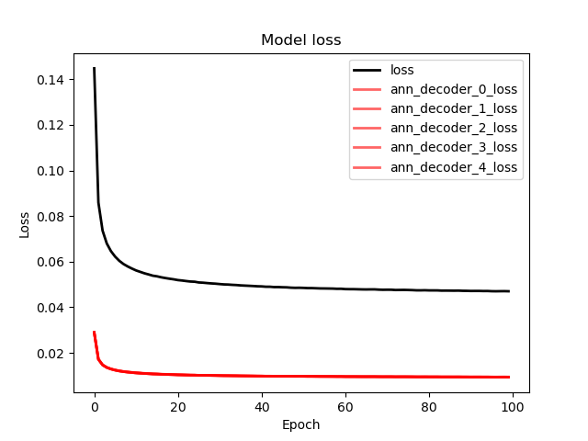

Slide 33
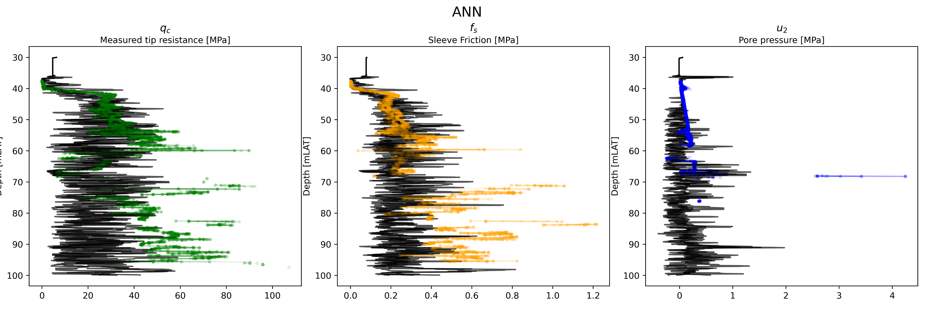

Slide 34
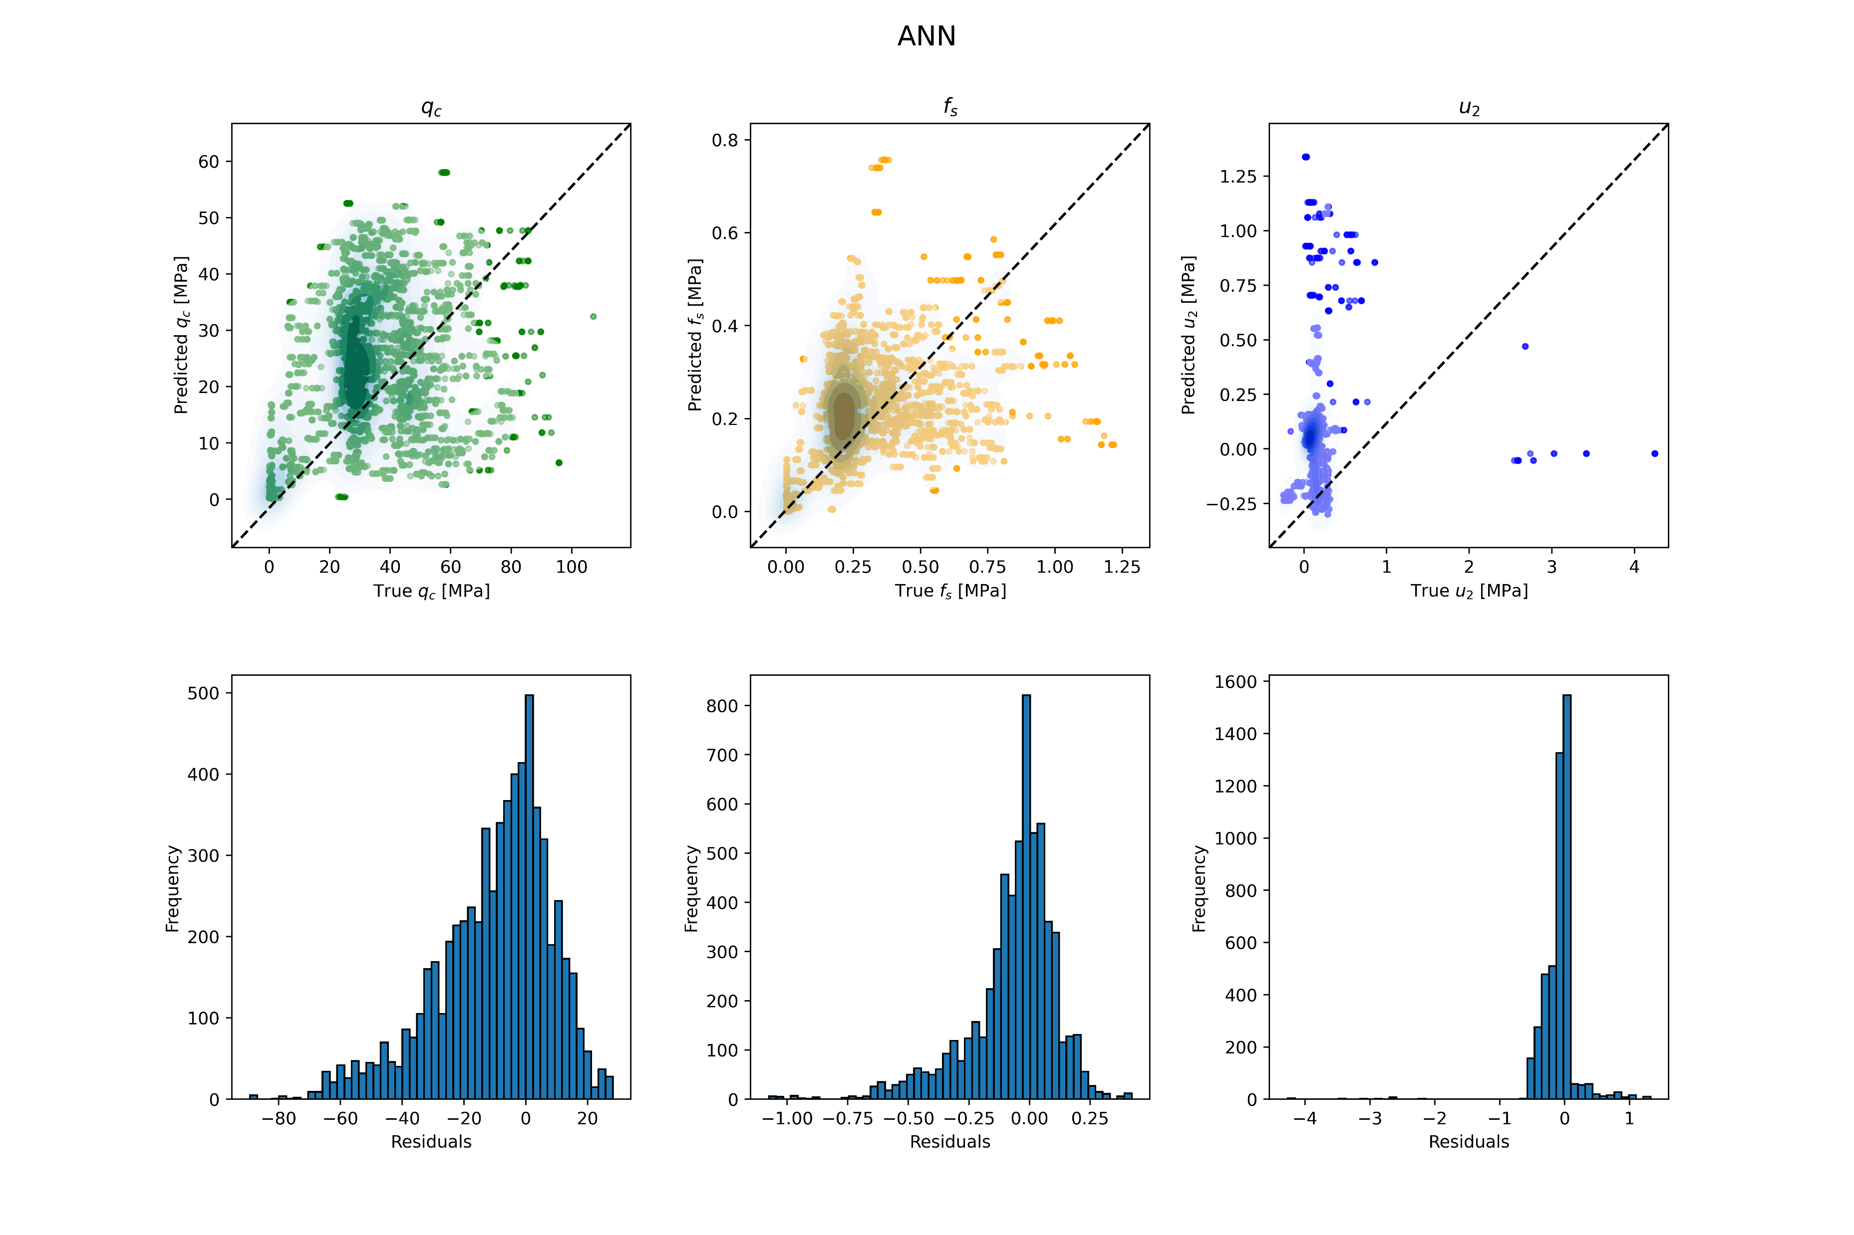

Slide 35
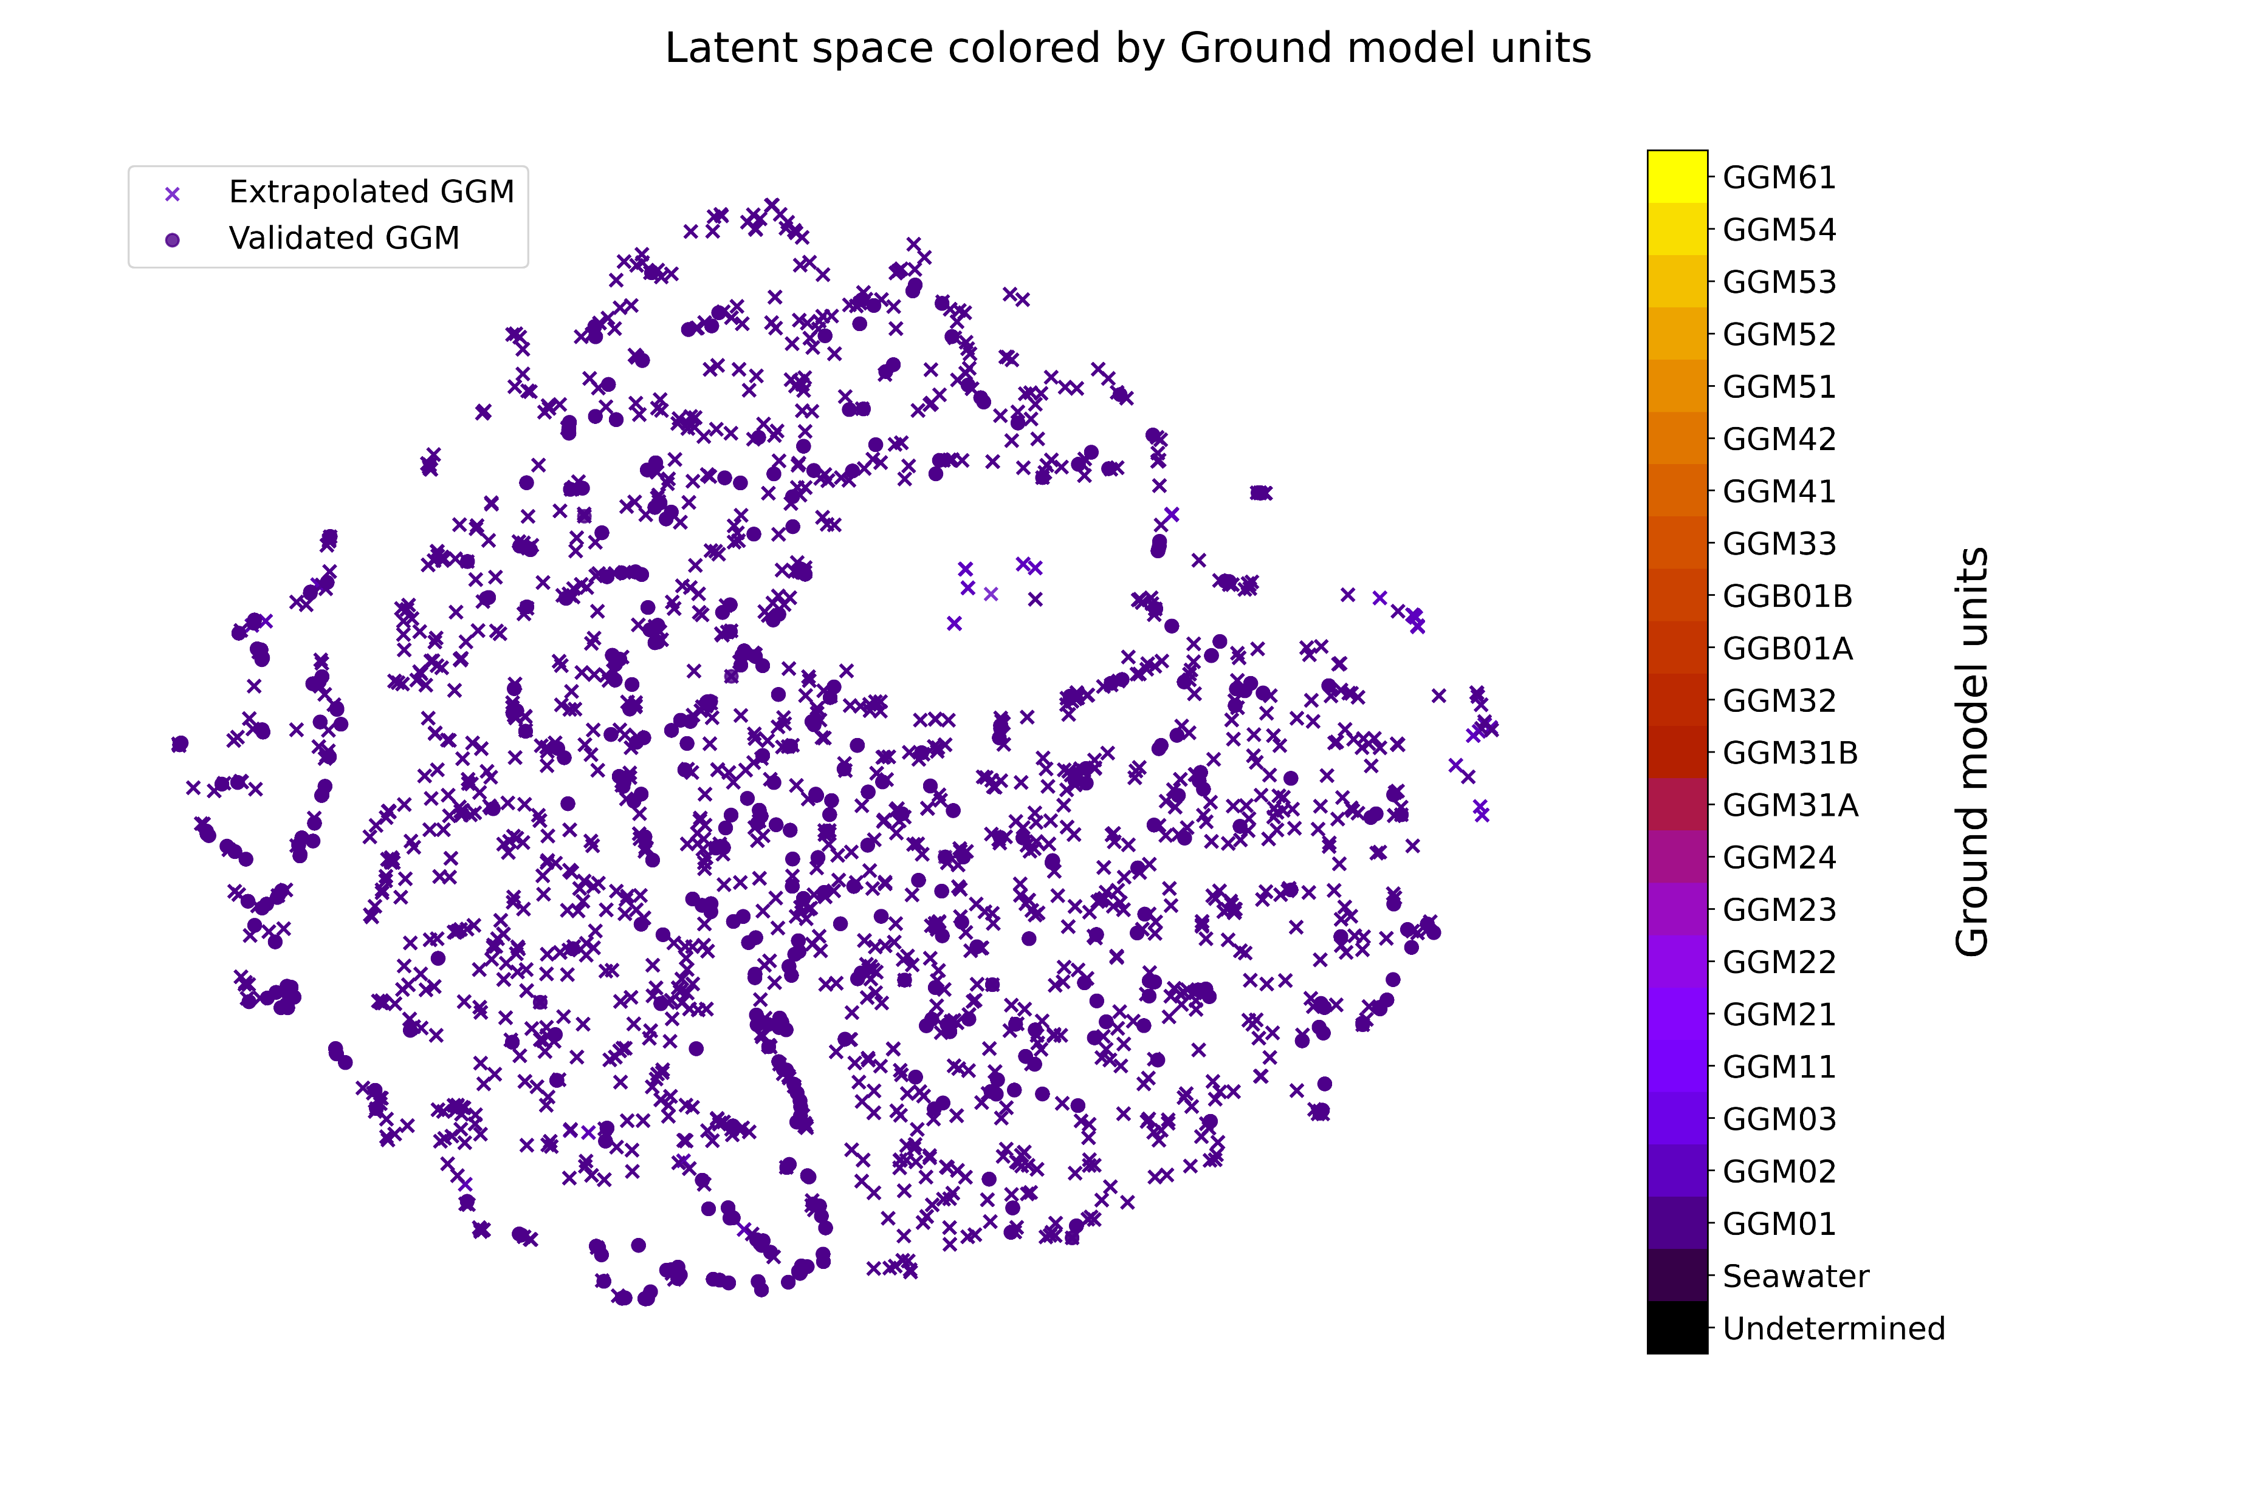

Slide 36
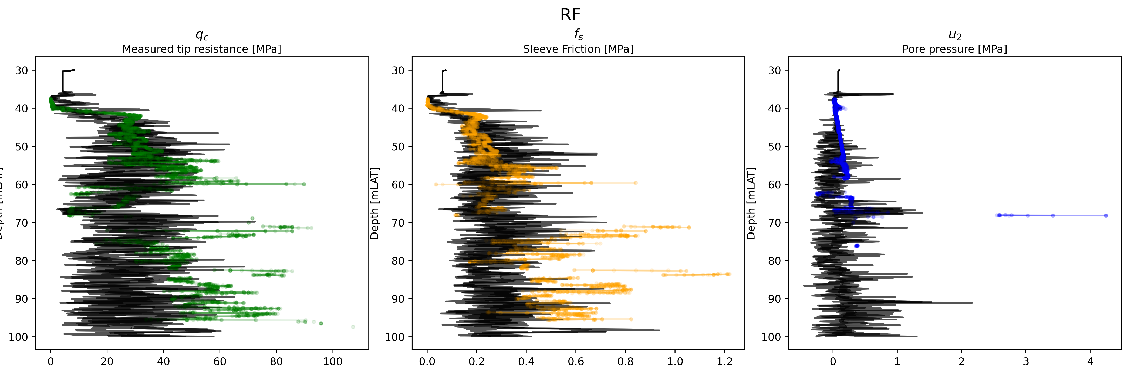

Slide 37
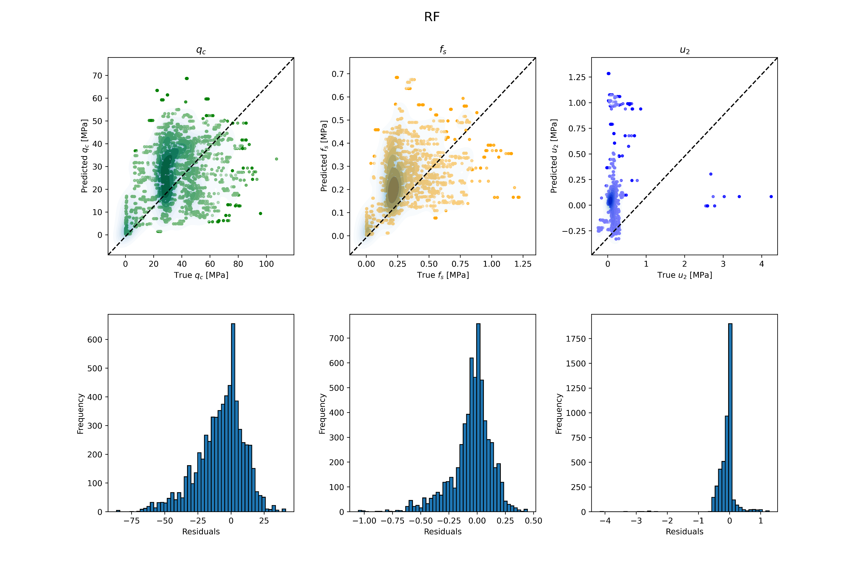

Slide 38


Slide 39
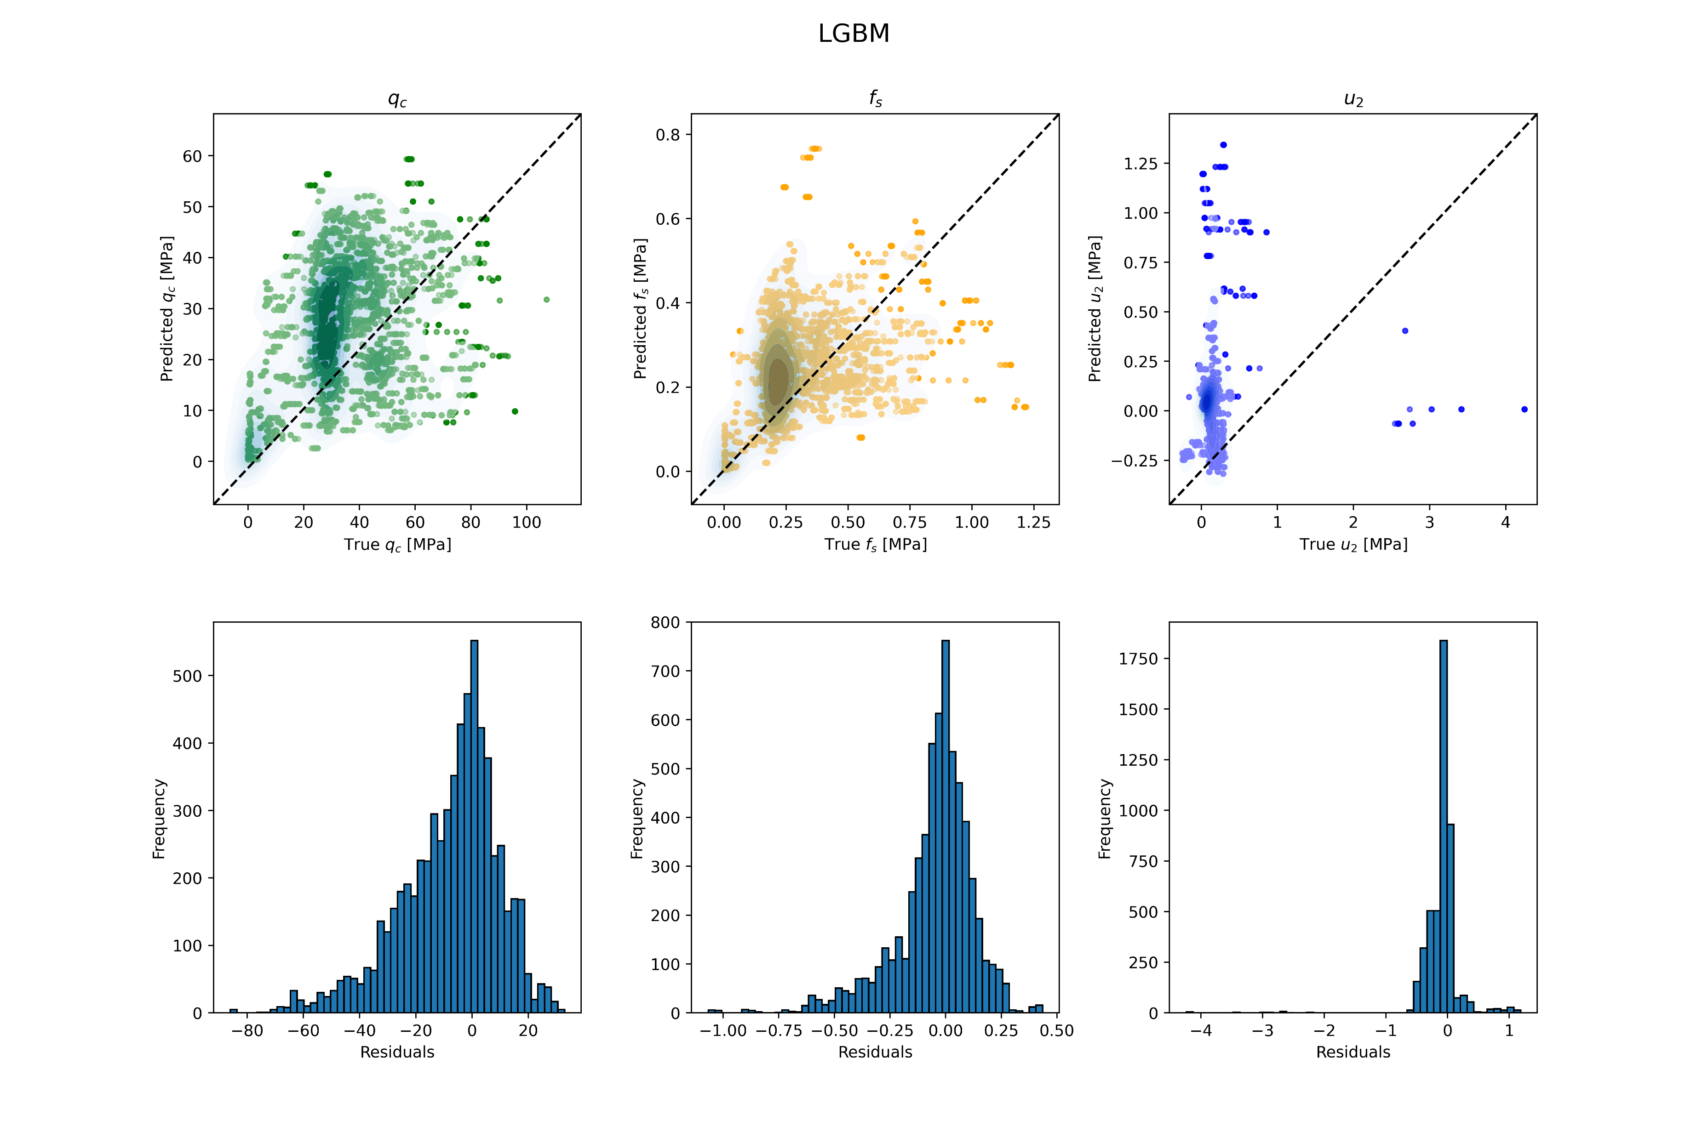

Slide 40
Single ANN Decoder

Slide 41
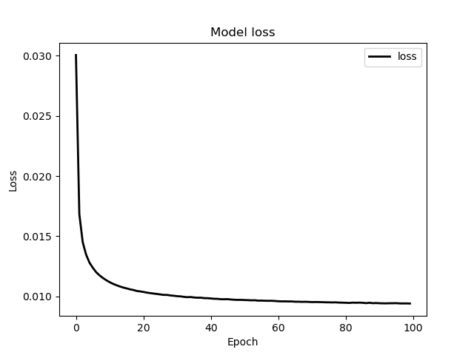

Slide 42
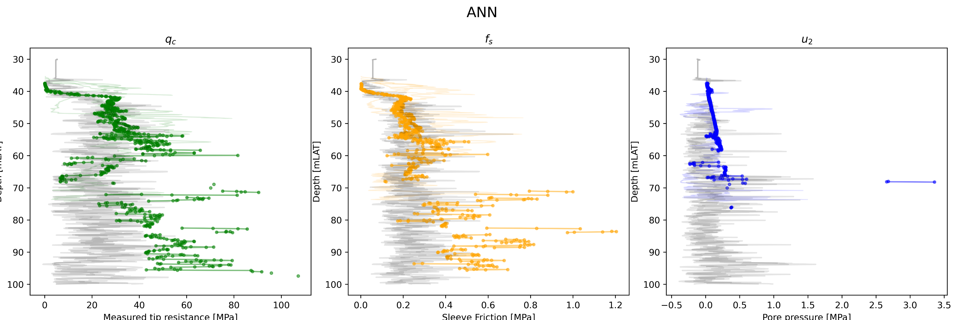

Slide 43
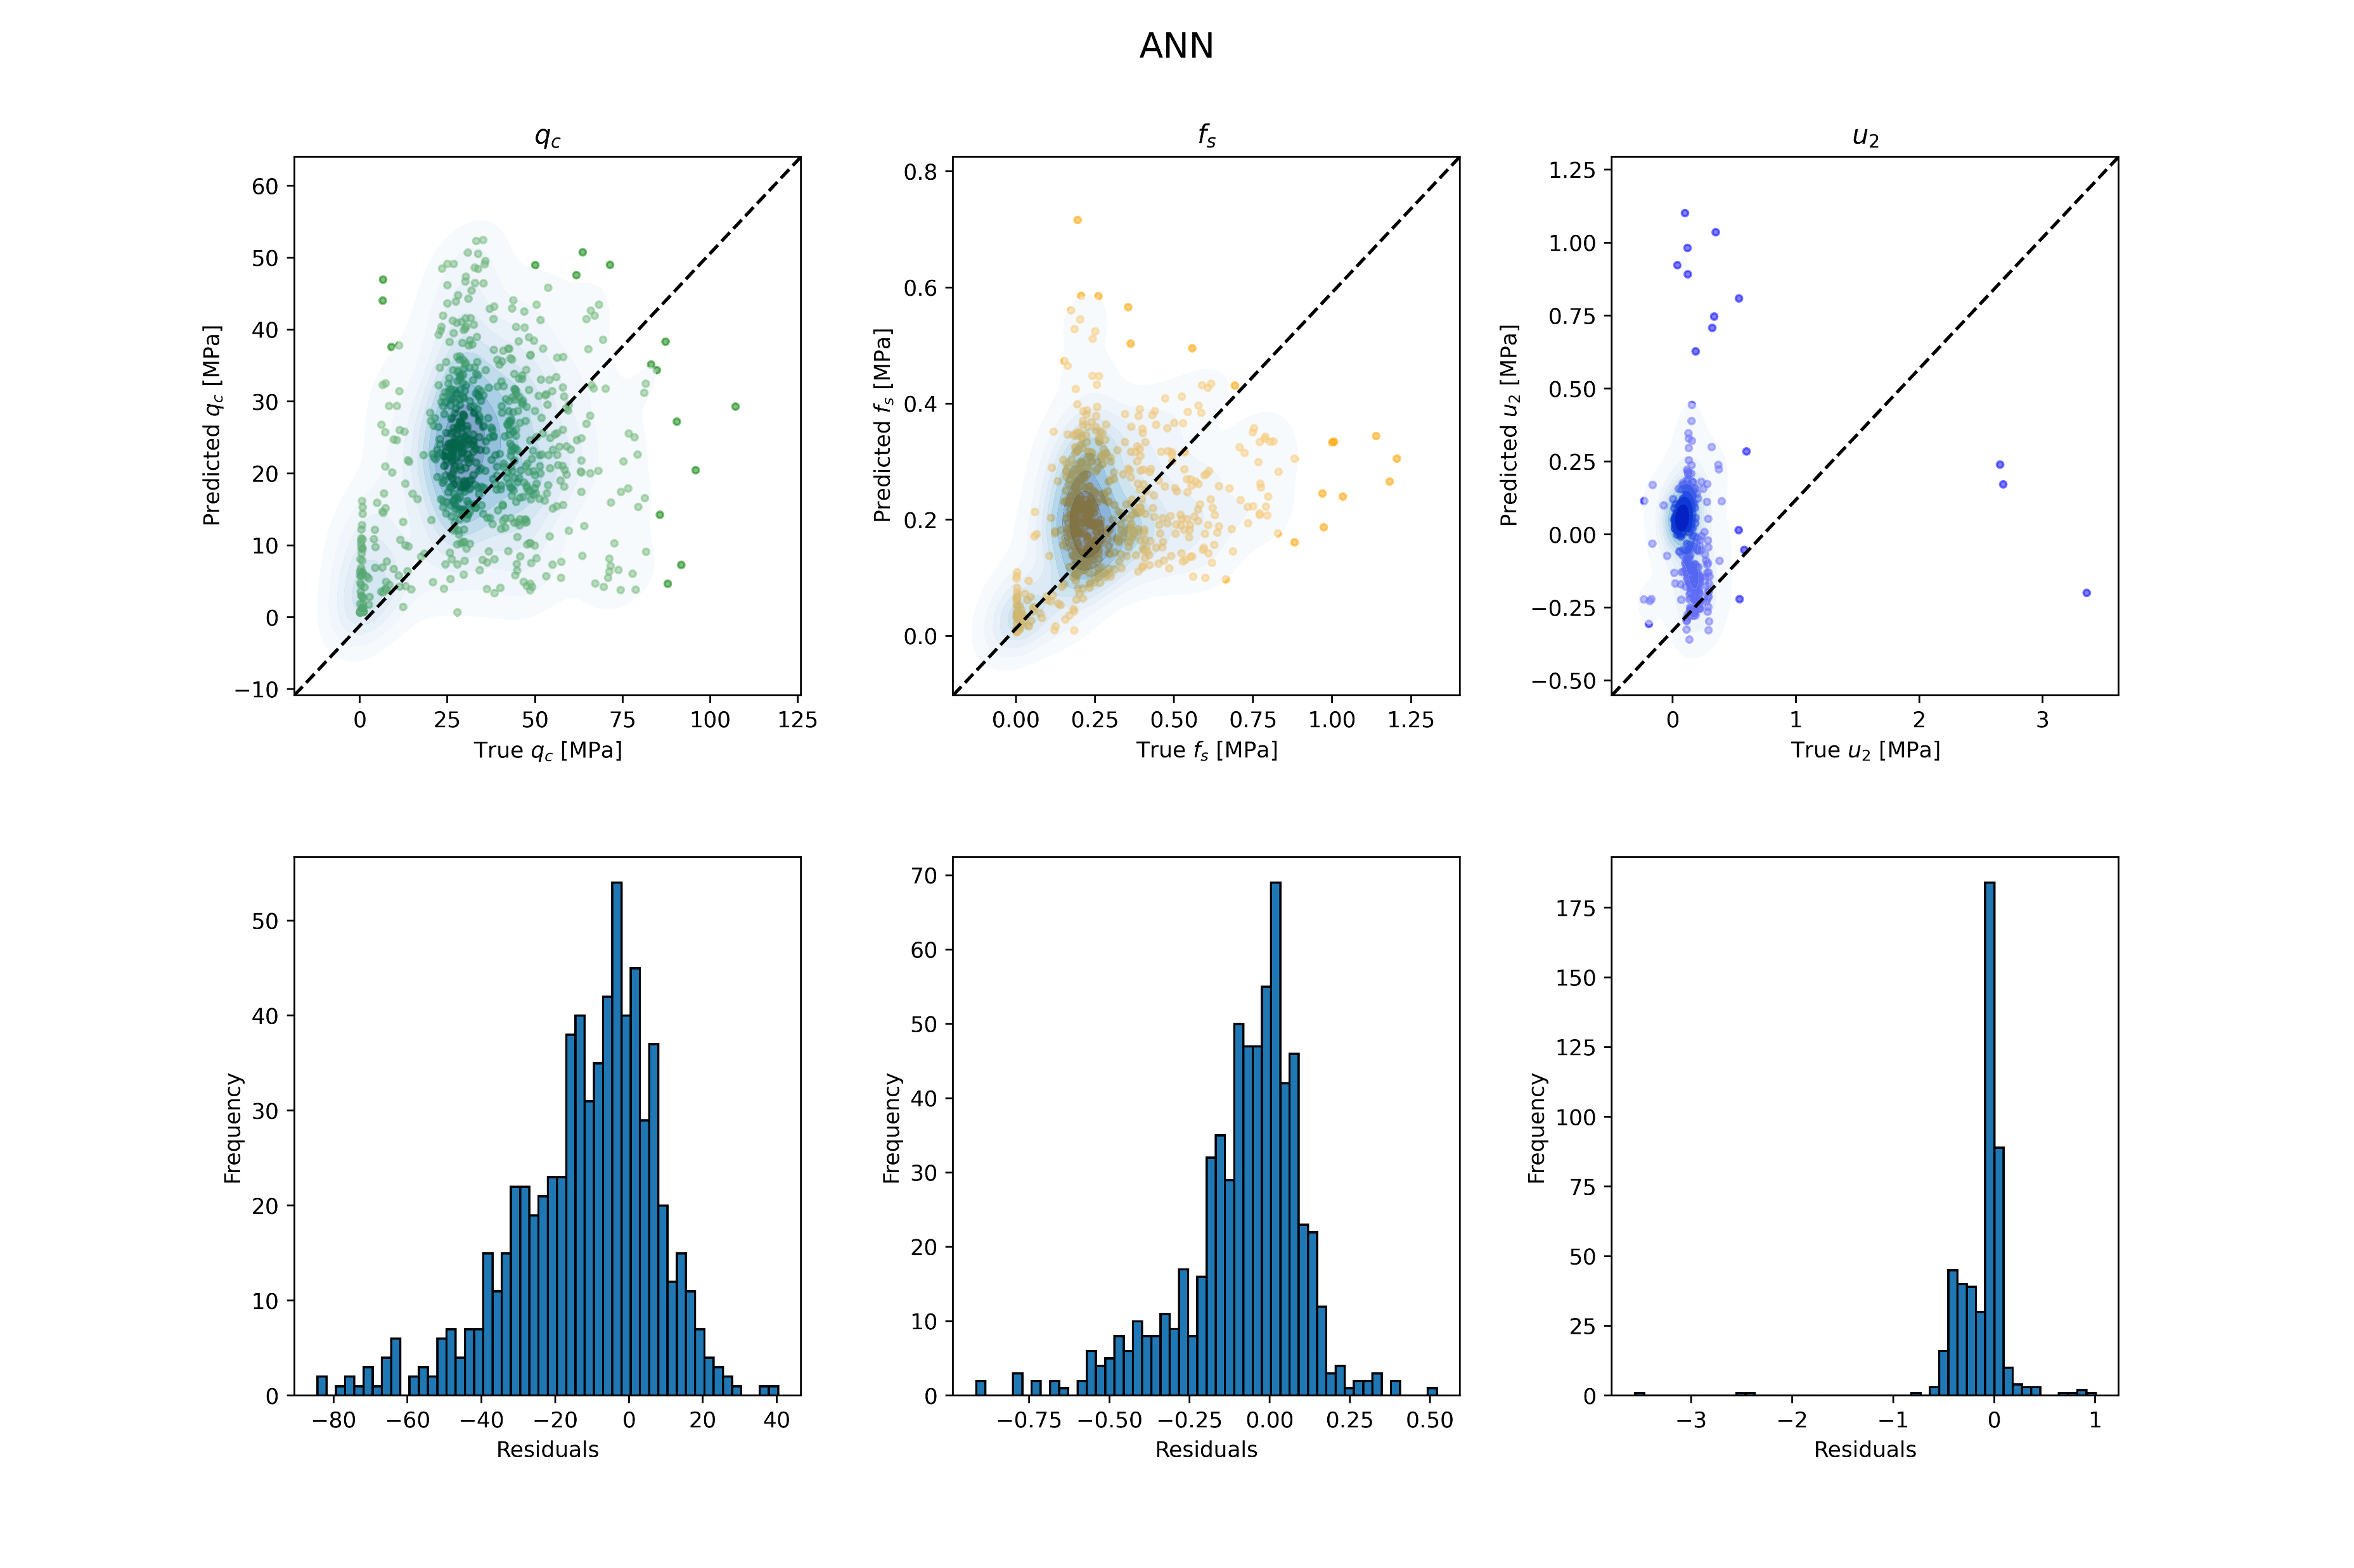

Slide 44
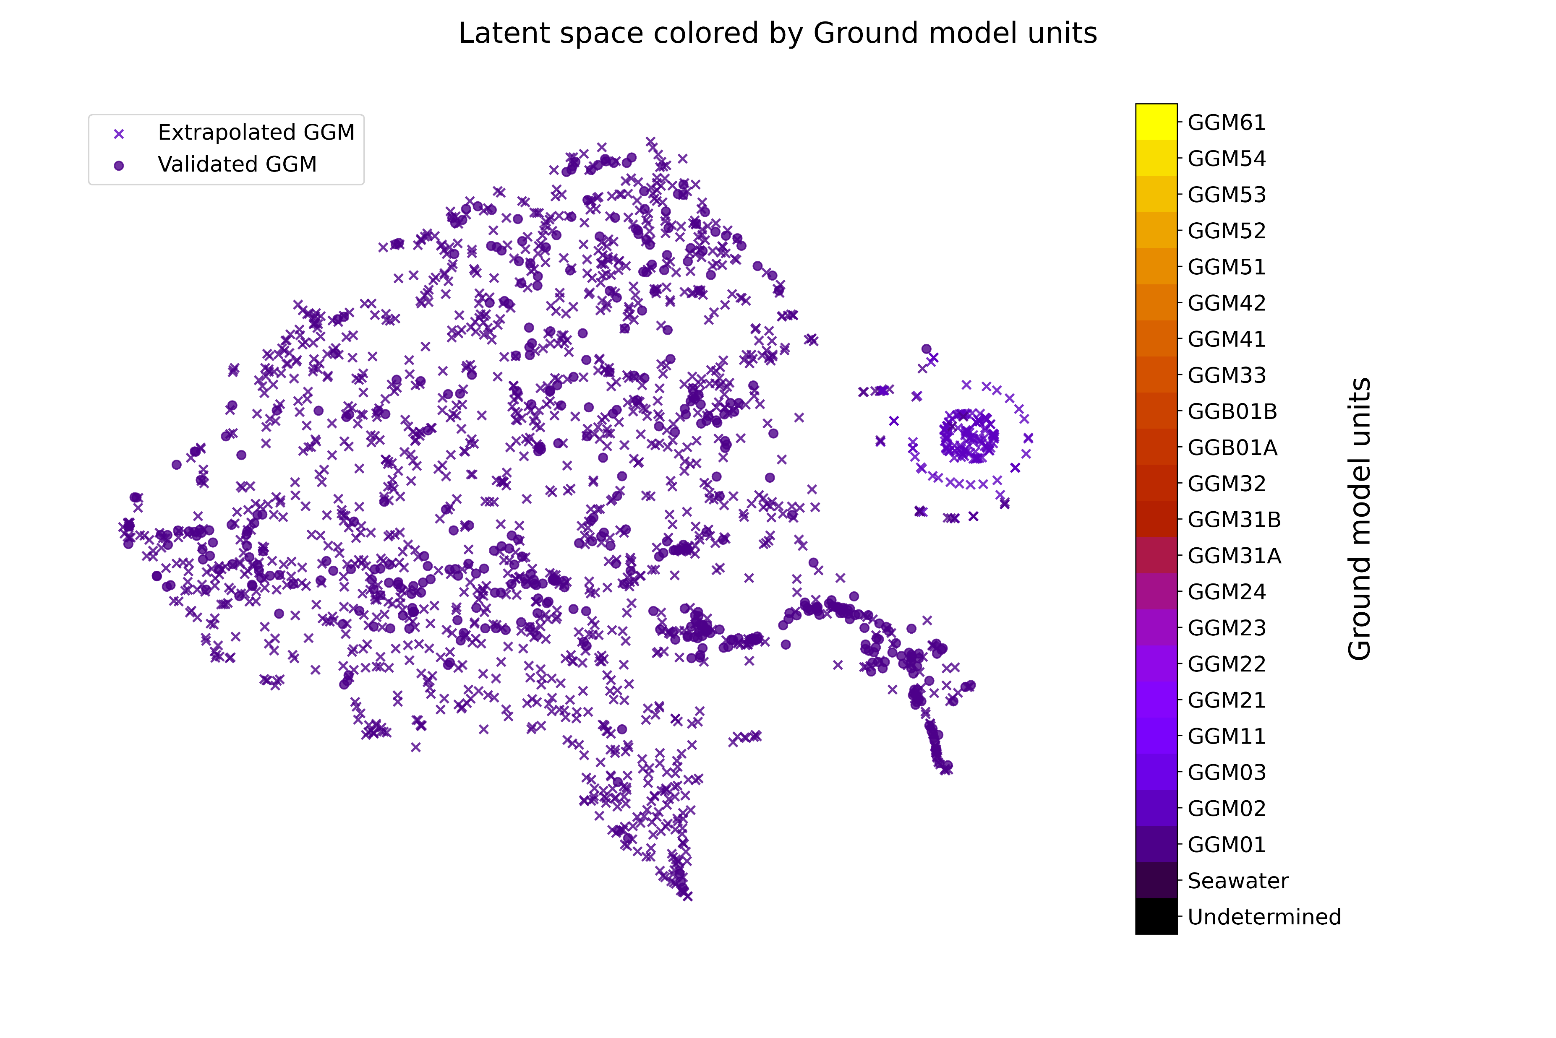

Slide 49
Latent units

Slide 50
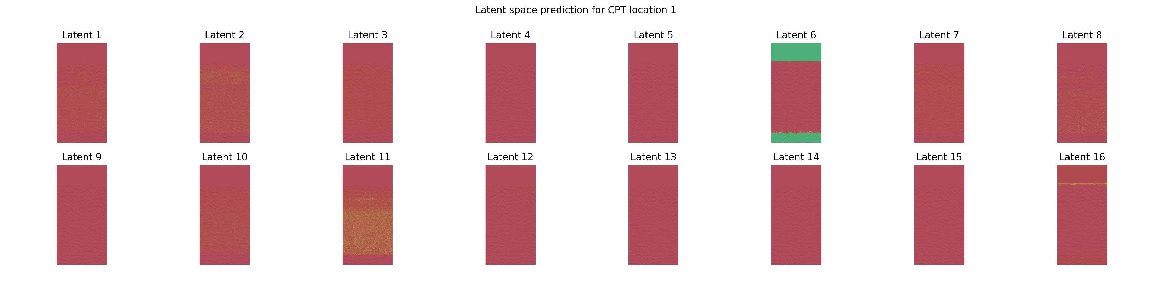
This is based on model AOF, which is a CNN decoder model

Slide 51
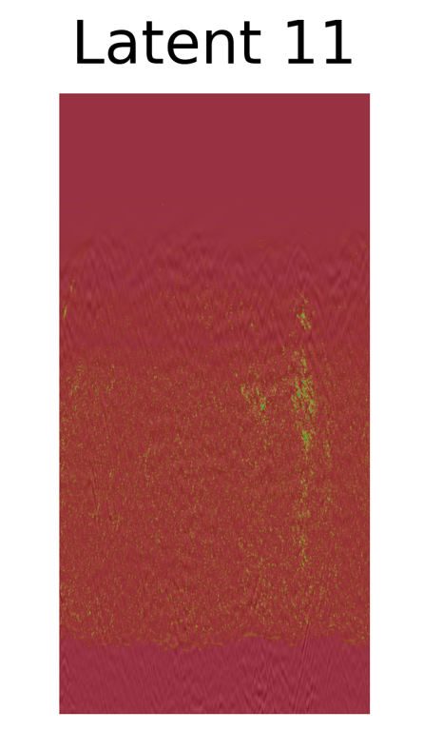
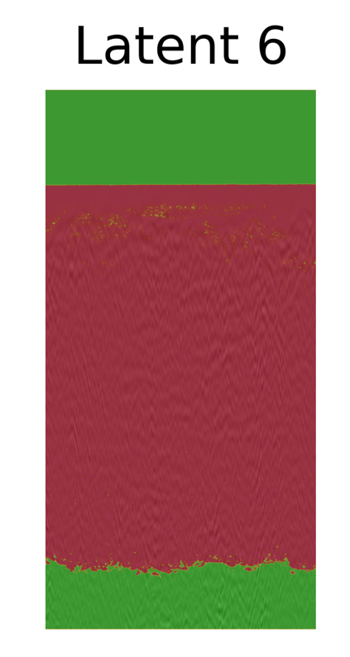


Slide 52
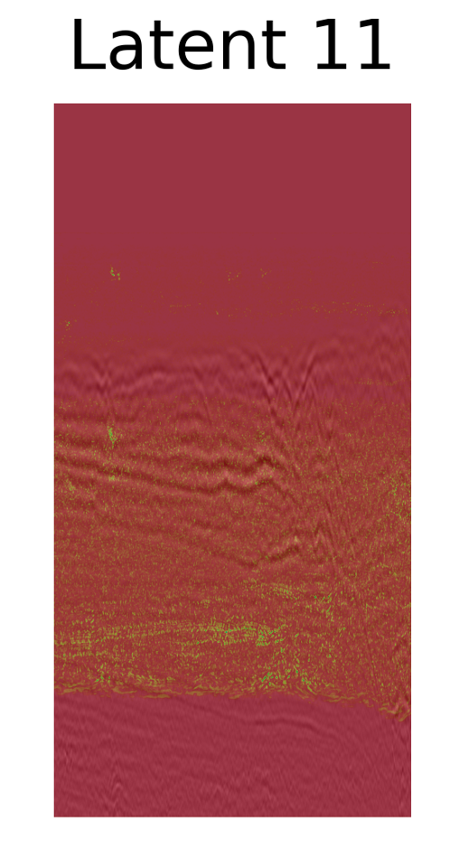

Slide 53
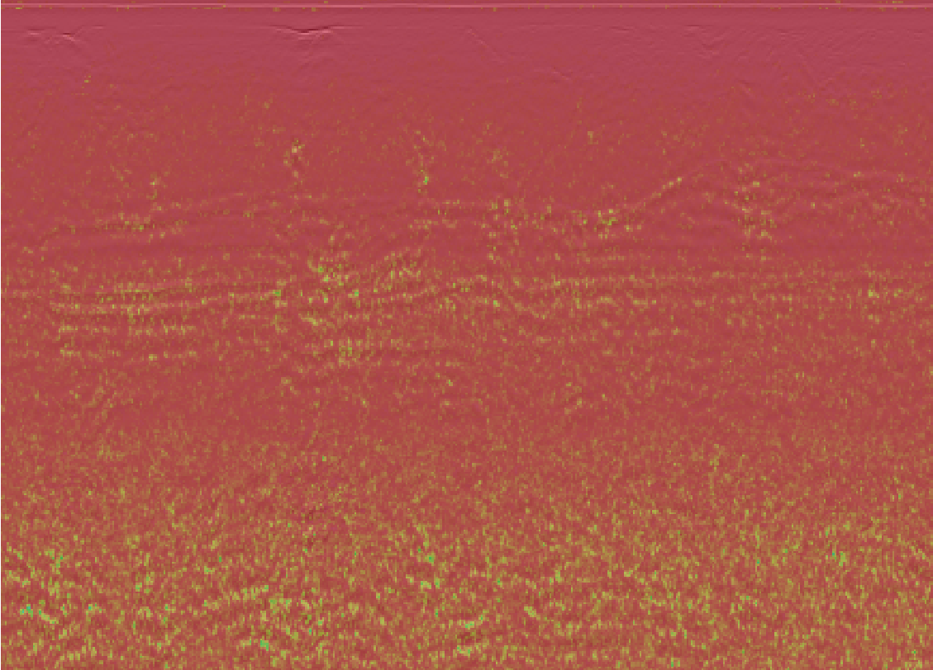

Slide 54


Slide 55
Model evaluation
I’m training with the bootstraps, but when evaluating the model it seems not to be helping
There is a general trend of overpredicting around 0
Where the CPT values are large, the measurements are more discontinuous, which lead to shorter sequences. This leads to underprediction in the deeper traces, perhps because measurements aren’t seen in the training set

Slide 56
Model comparisons
LSTMs are more well behaved during training
Ensembles of LSTM and CNN tend to find the same minima (I think), whilst ensembles of ANN find different ones
ANN and LSTM have the most well behaved latent space, e.g. The tree models get better predictions

Slide 57
Data
Adding the traces that are longer from a CDP tends to hurt generalization of the models.
Adding bootstraps does not seem to give better model results, only makes training take longer, it may cause a cleaner latent space due to variational encoding

Slide 58
GGM for stats and plotting
The code Guillaume sent me uses the Database.csv

